Slide 1
IBM Rational Integration Tester

Slide 2








About CloudThat​
9+
350k+
100+
100+
350+
Years in Business
Professional Trained
Corporates Trained
Projects Delivered
Cloud Certifications
Leader in Training and Consulting on Cloud, Security, AI/ML, IoT and DevOps
Trained over 350k+ professionals across technologies and geographies
Proven track record of training delivery for all stages of employee lifecycle
Strong team of 125+ certified cloud experts with
industry consulting experience
Robust consulting division brings industry prospective to training delivery
Page 2

Slide 3
PREREQUISITES:
Basic understanding of software testing concepts
Familiarity with programming concepts
Understanding of web technologies
Database knowledge
Experience with test automation tools
Familiarity with version control systems
Basic understanding of Continuous Integration/Continuous Deployment (CI/CD)
Knowledge of GUI testing concepts (for RFT)
Understanding of load testing concepts and performance metrics (for RPT)
Knowledge of service-oriented architecture (SOA) concepts (for RIT)
Familiarity with managing virtual services and environments (for RTCP)

Slide 4
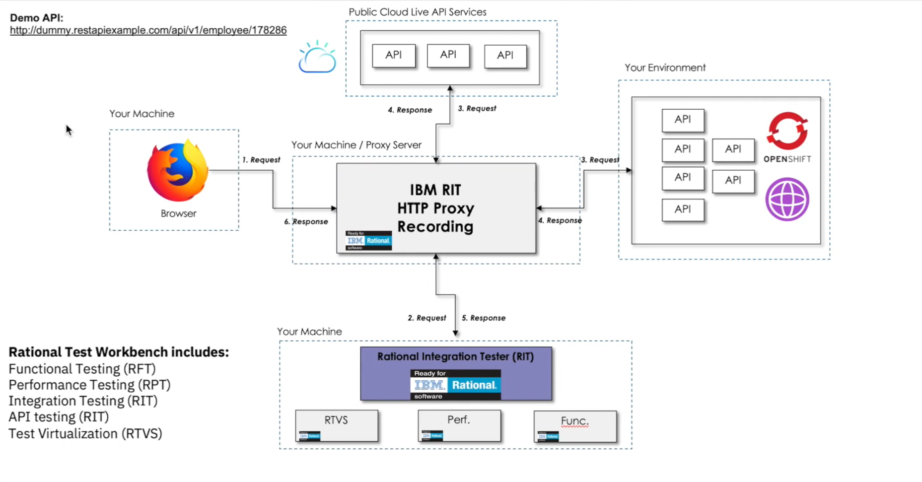
Use Case 1 High Level Architecture

Slide 5
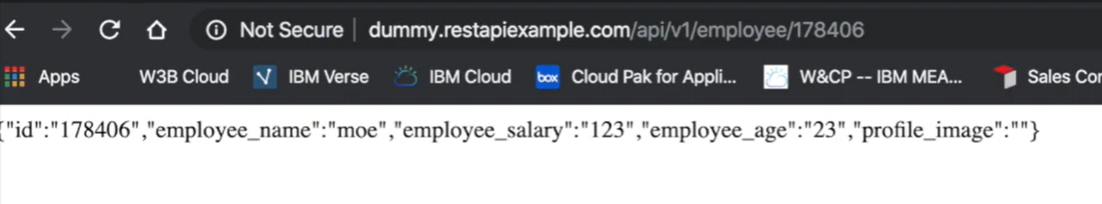
Sample API

Slide 6
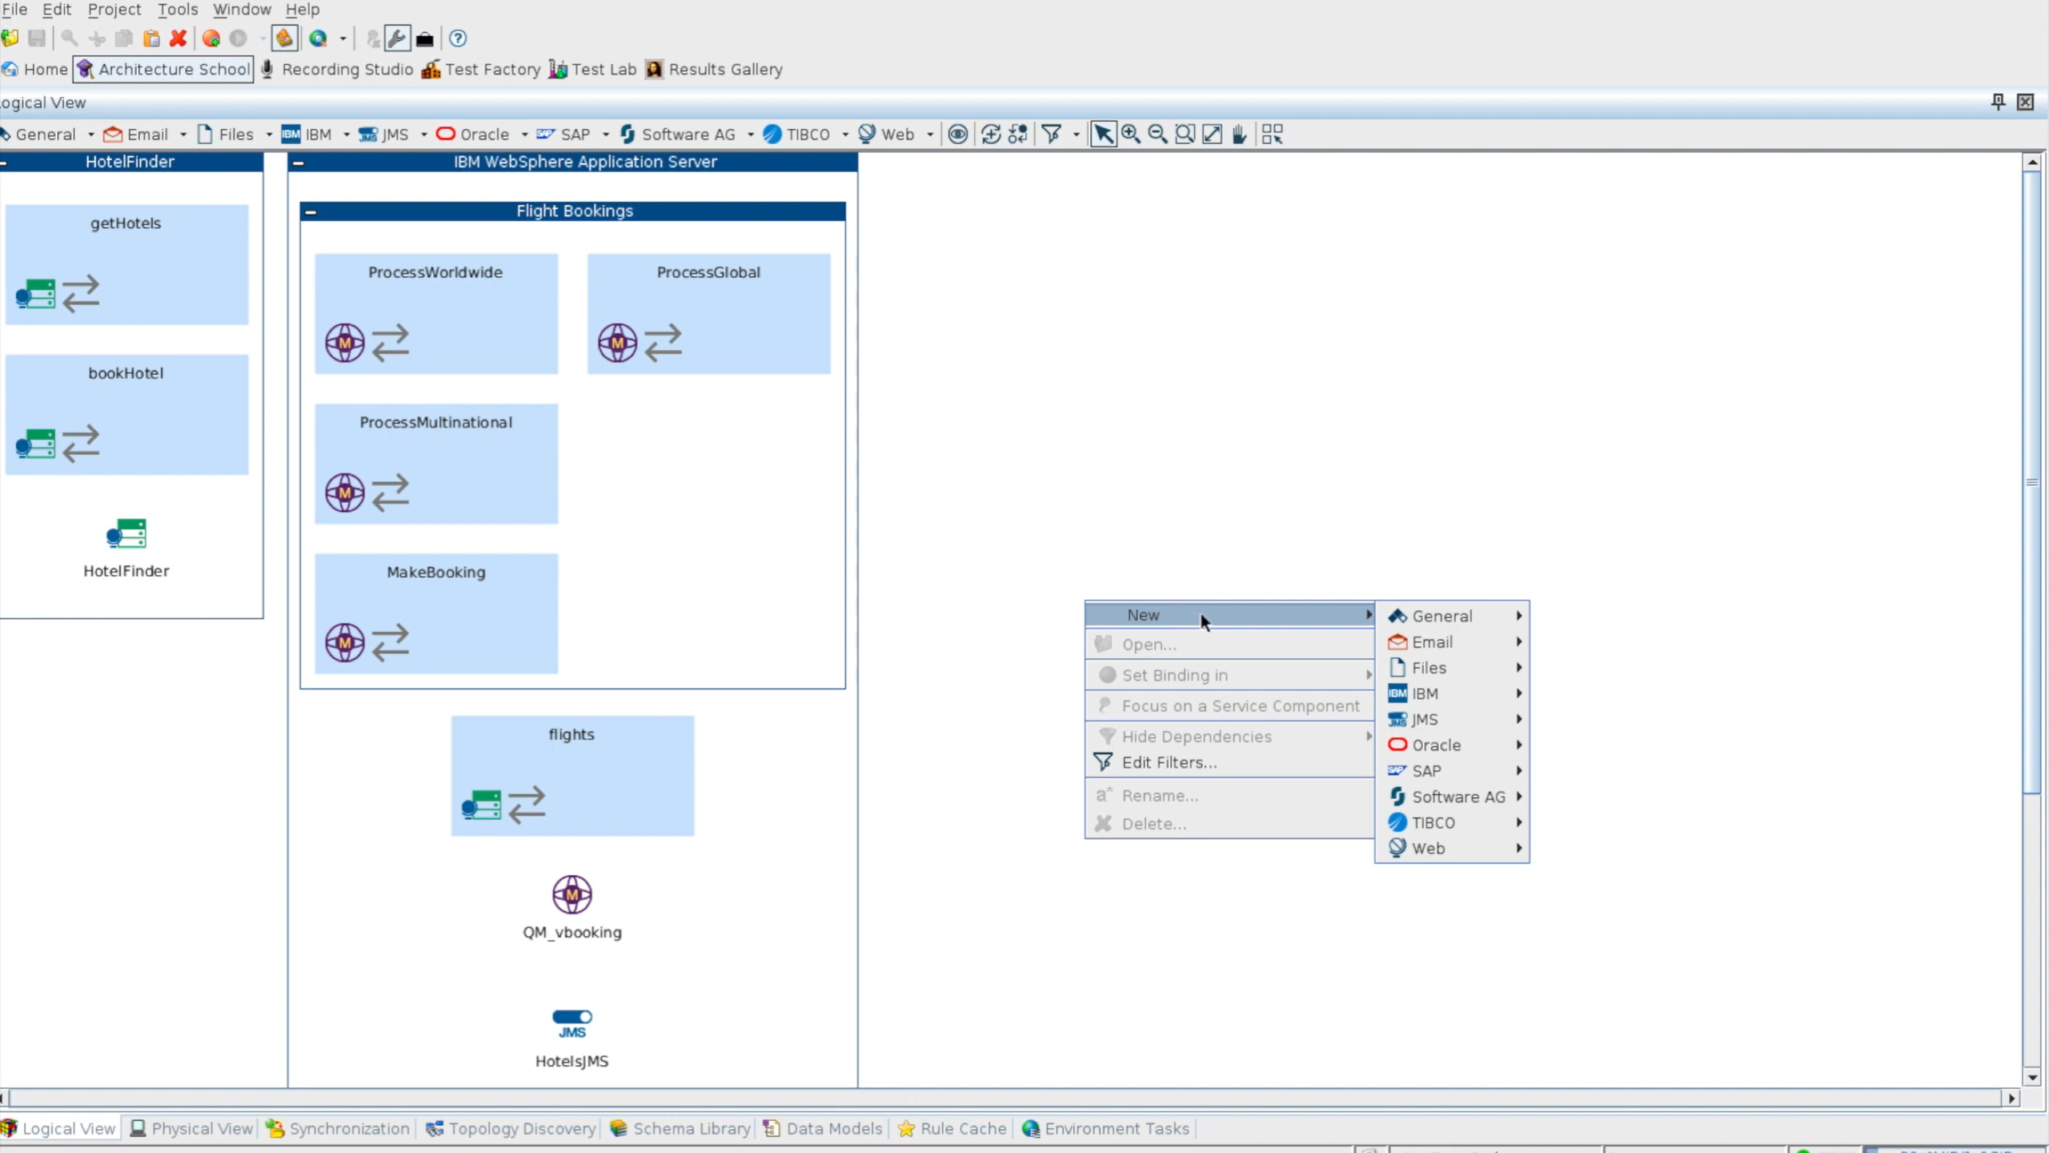

Slide 7
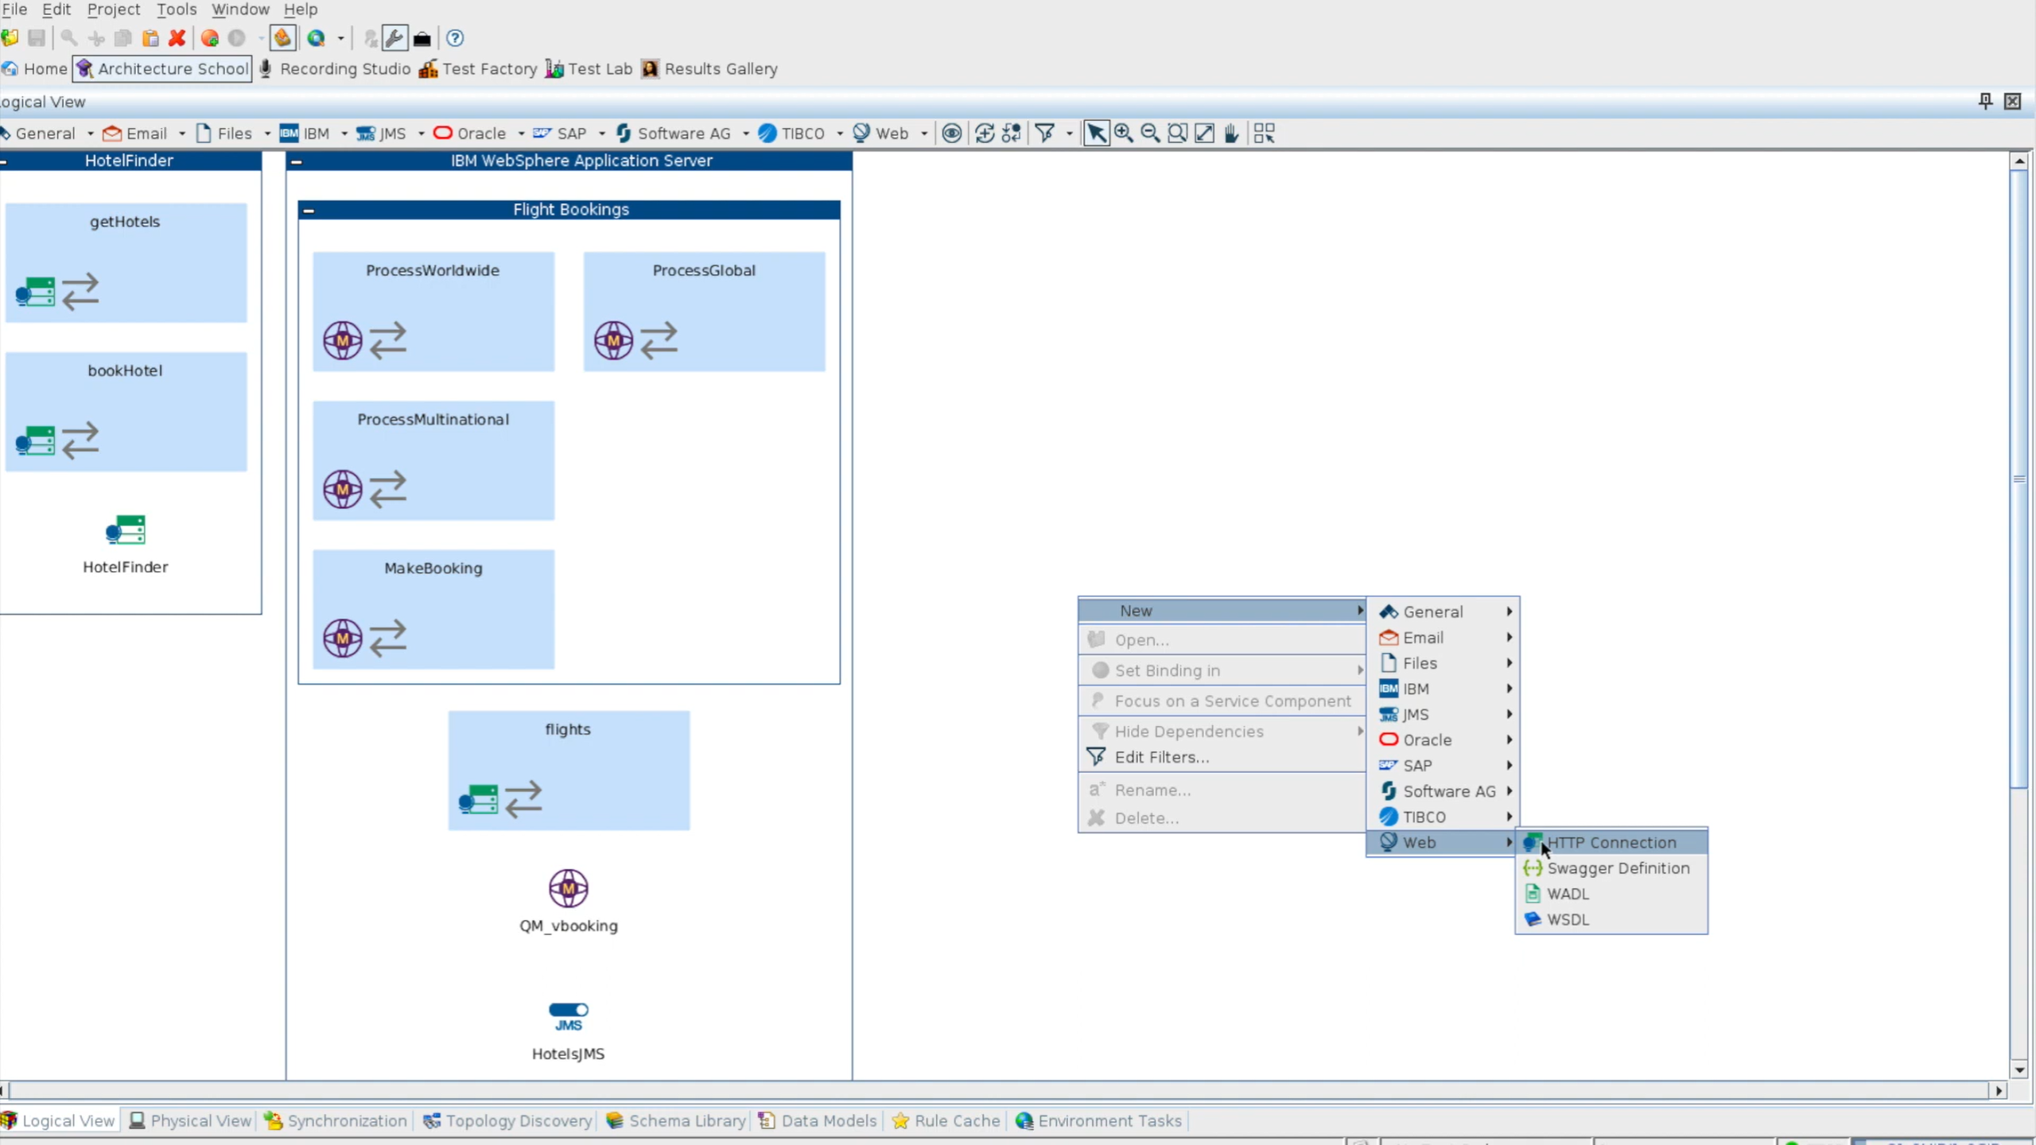

Slide 8
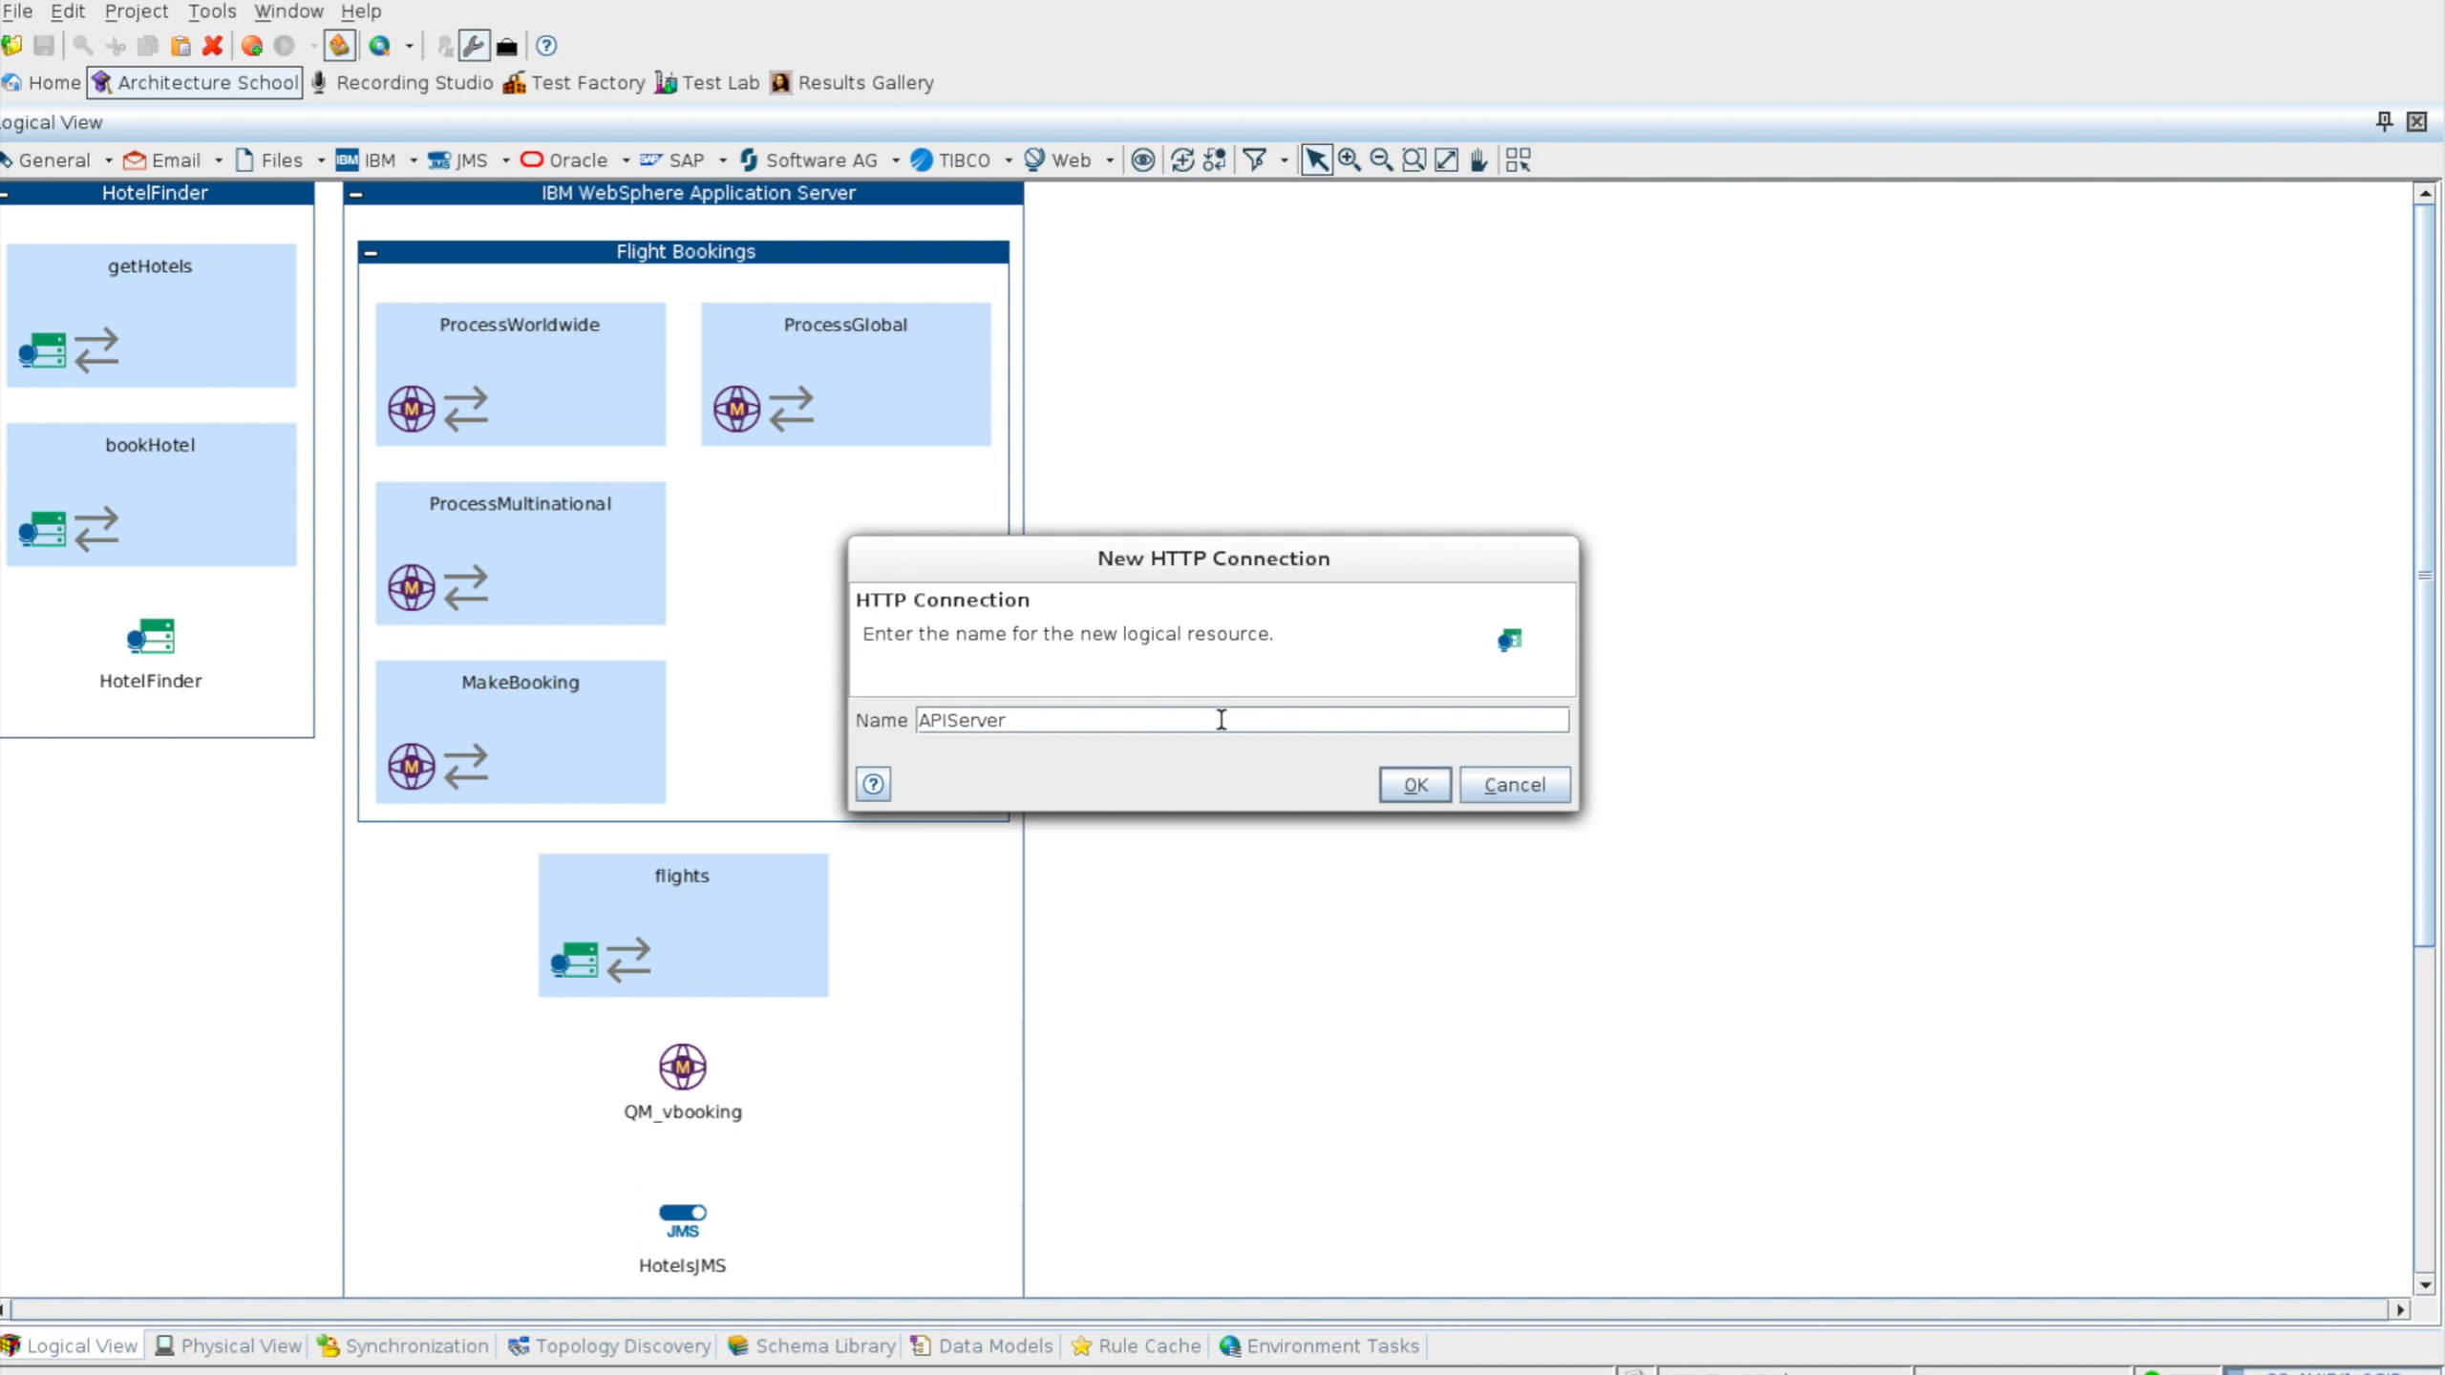

Slide 9
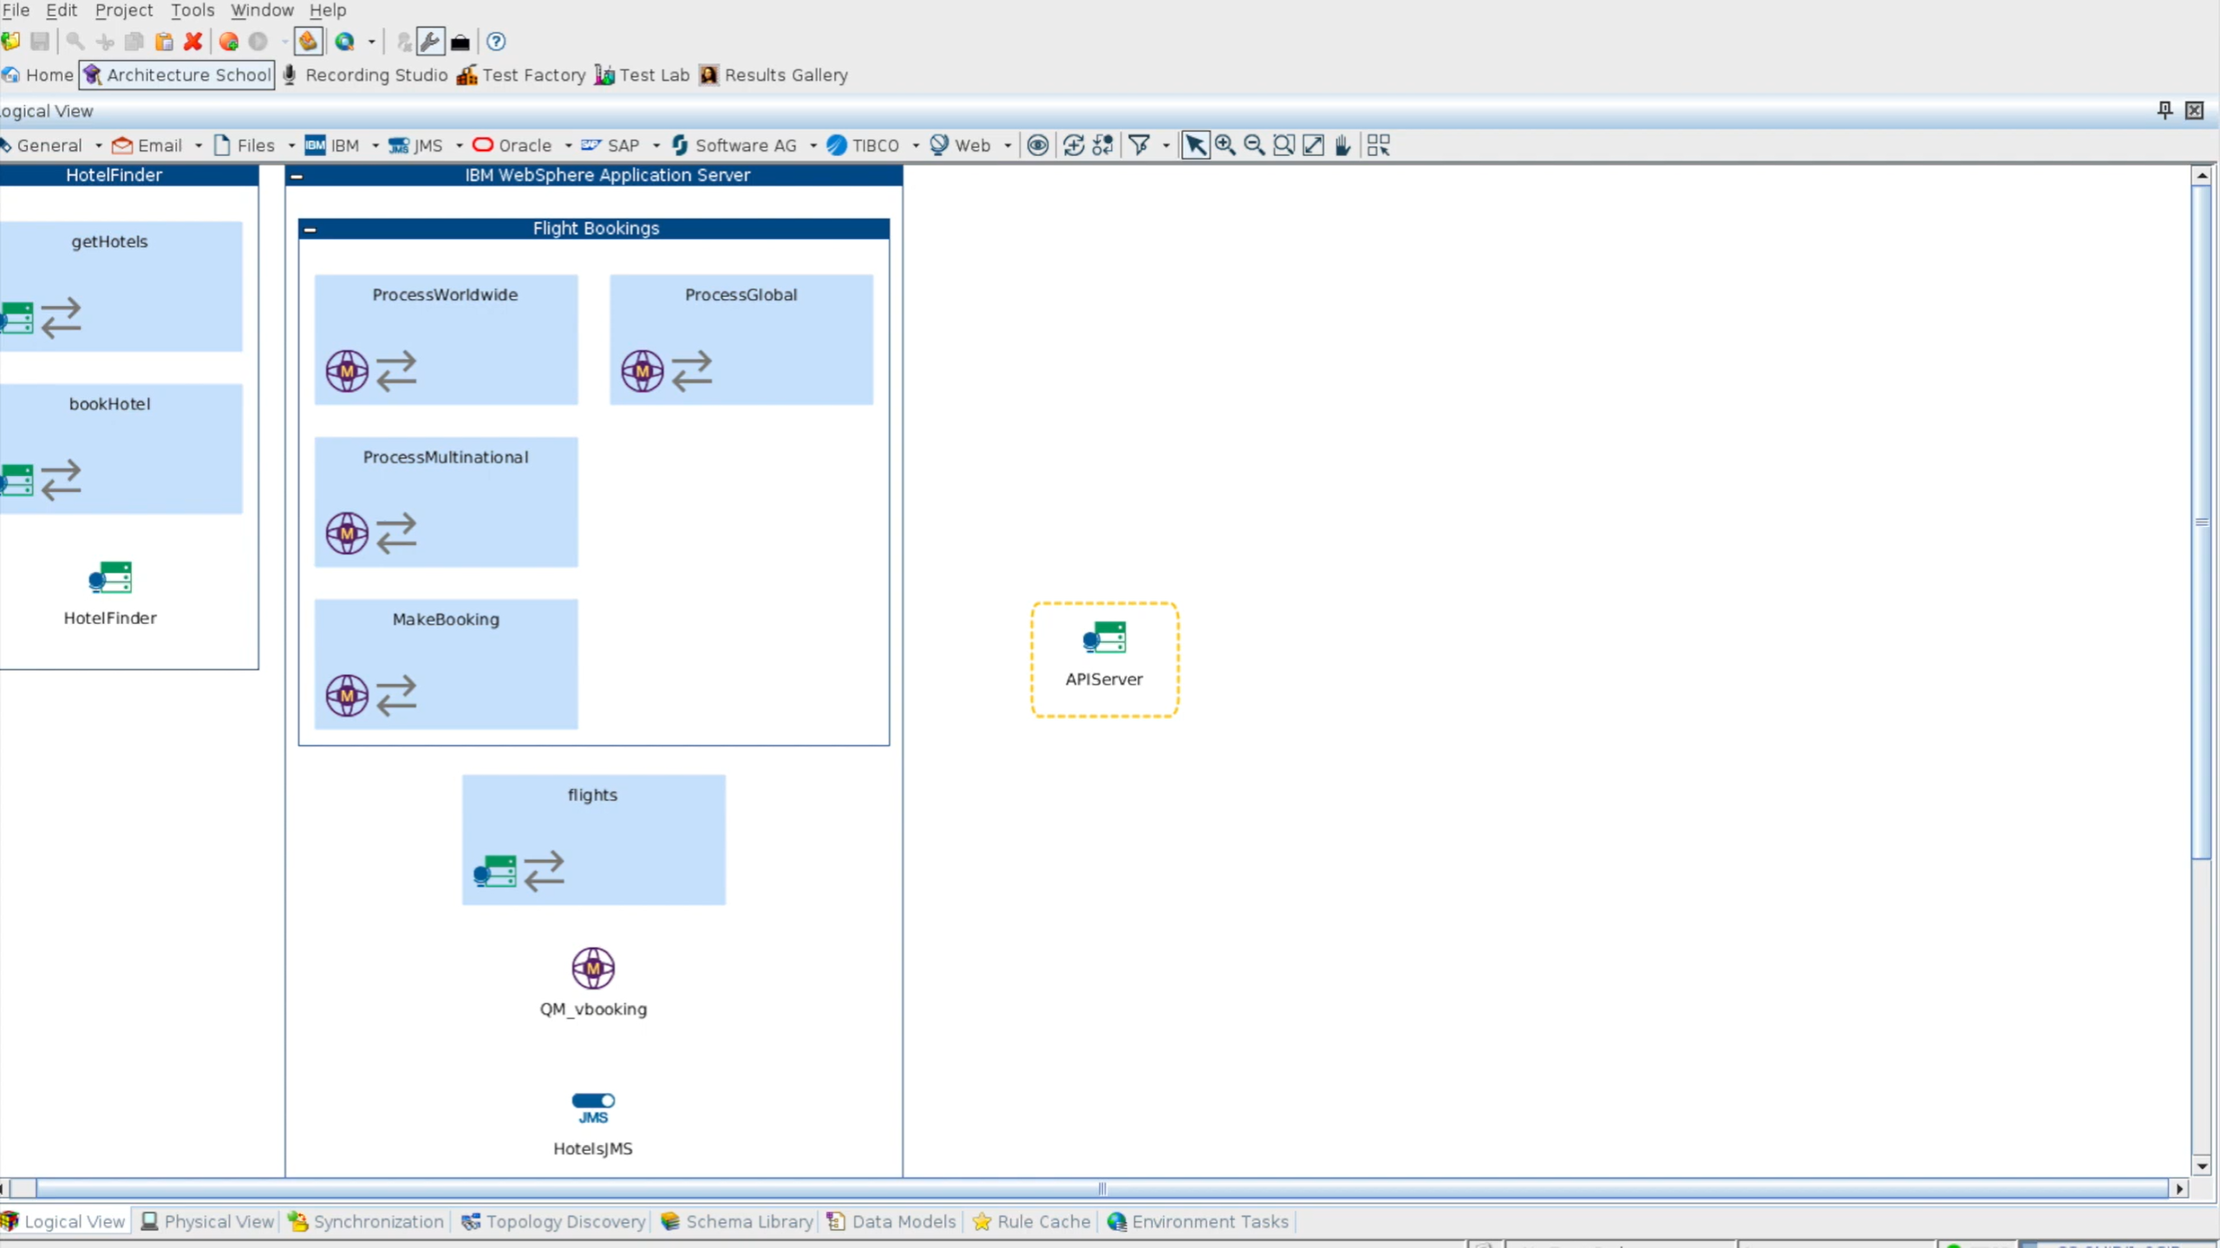

Slide 10


Slide 11
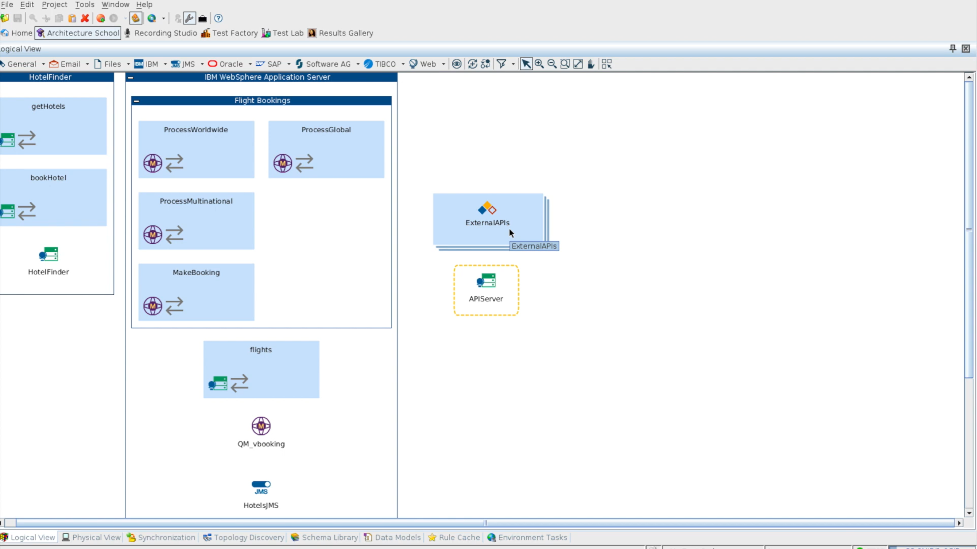
Now we need to bind these two
Double Click on API Server

Slide 12
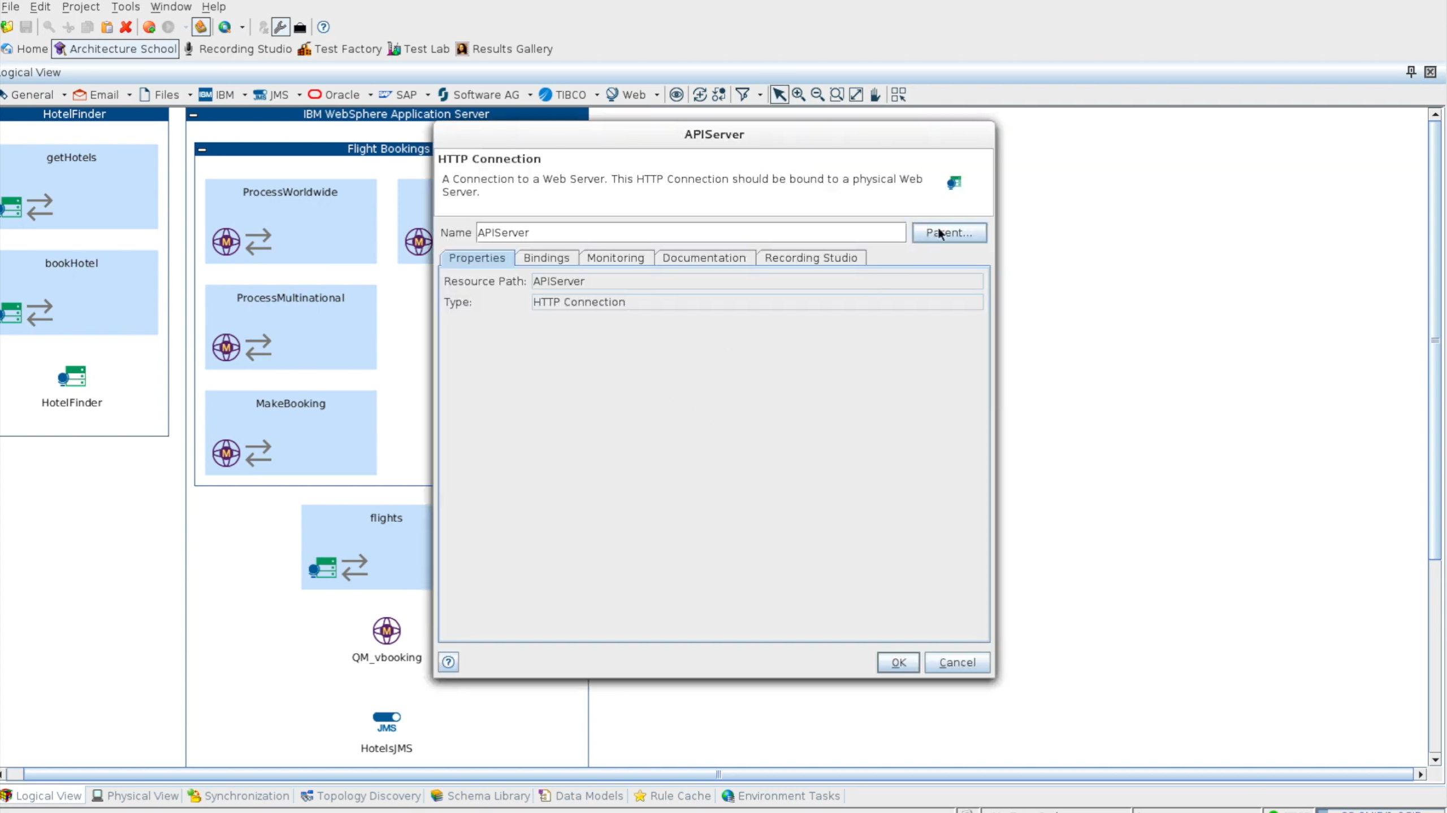

Slide 13
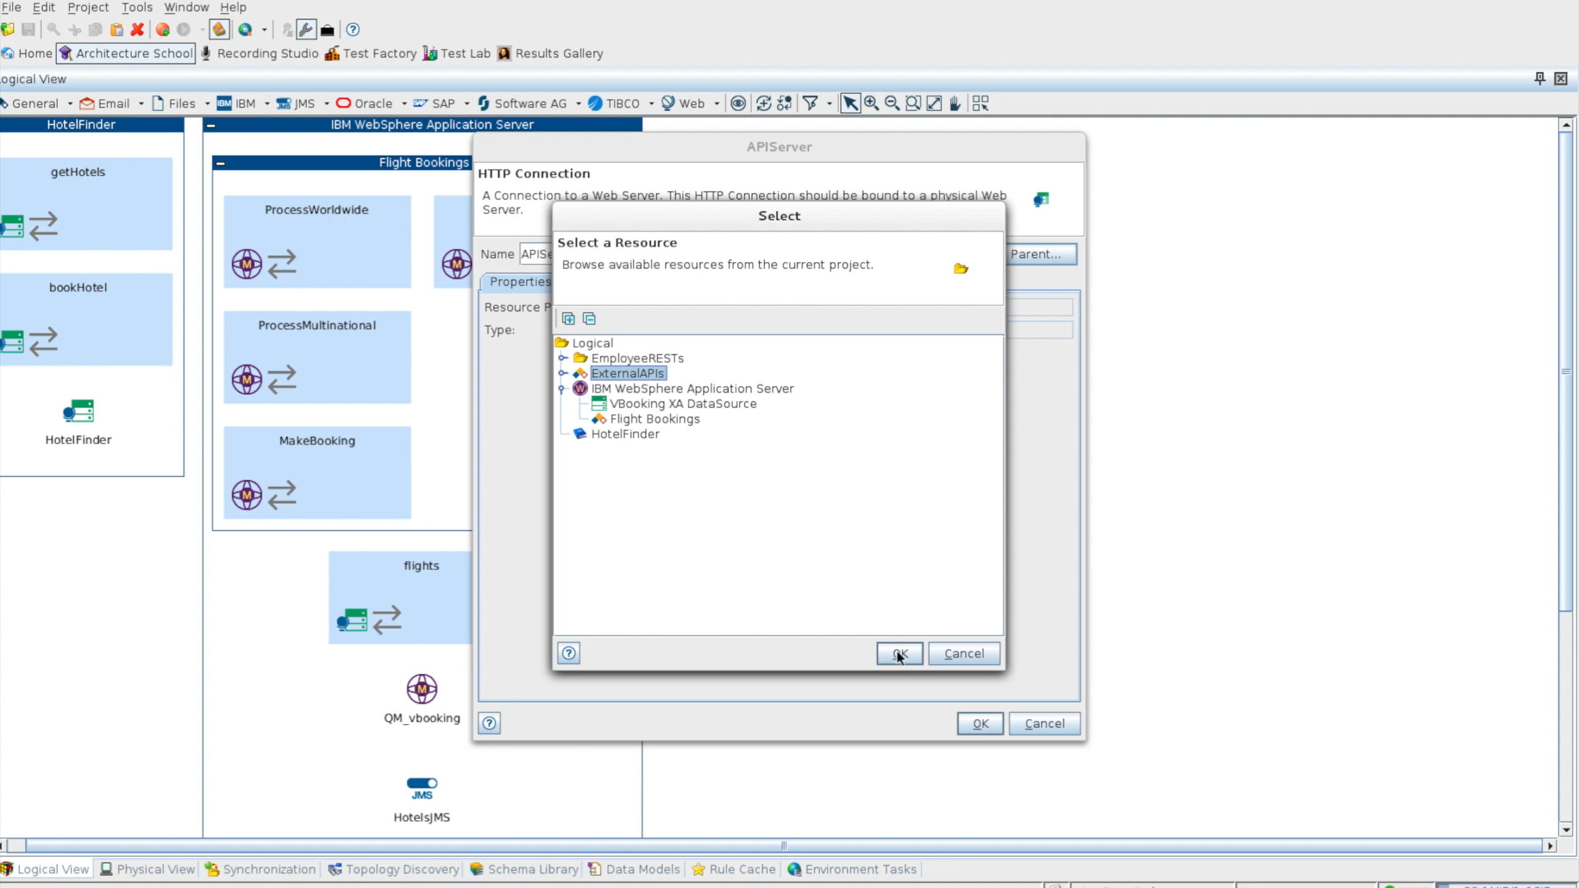

Slide 14
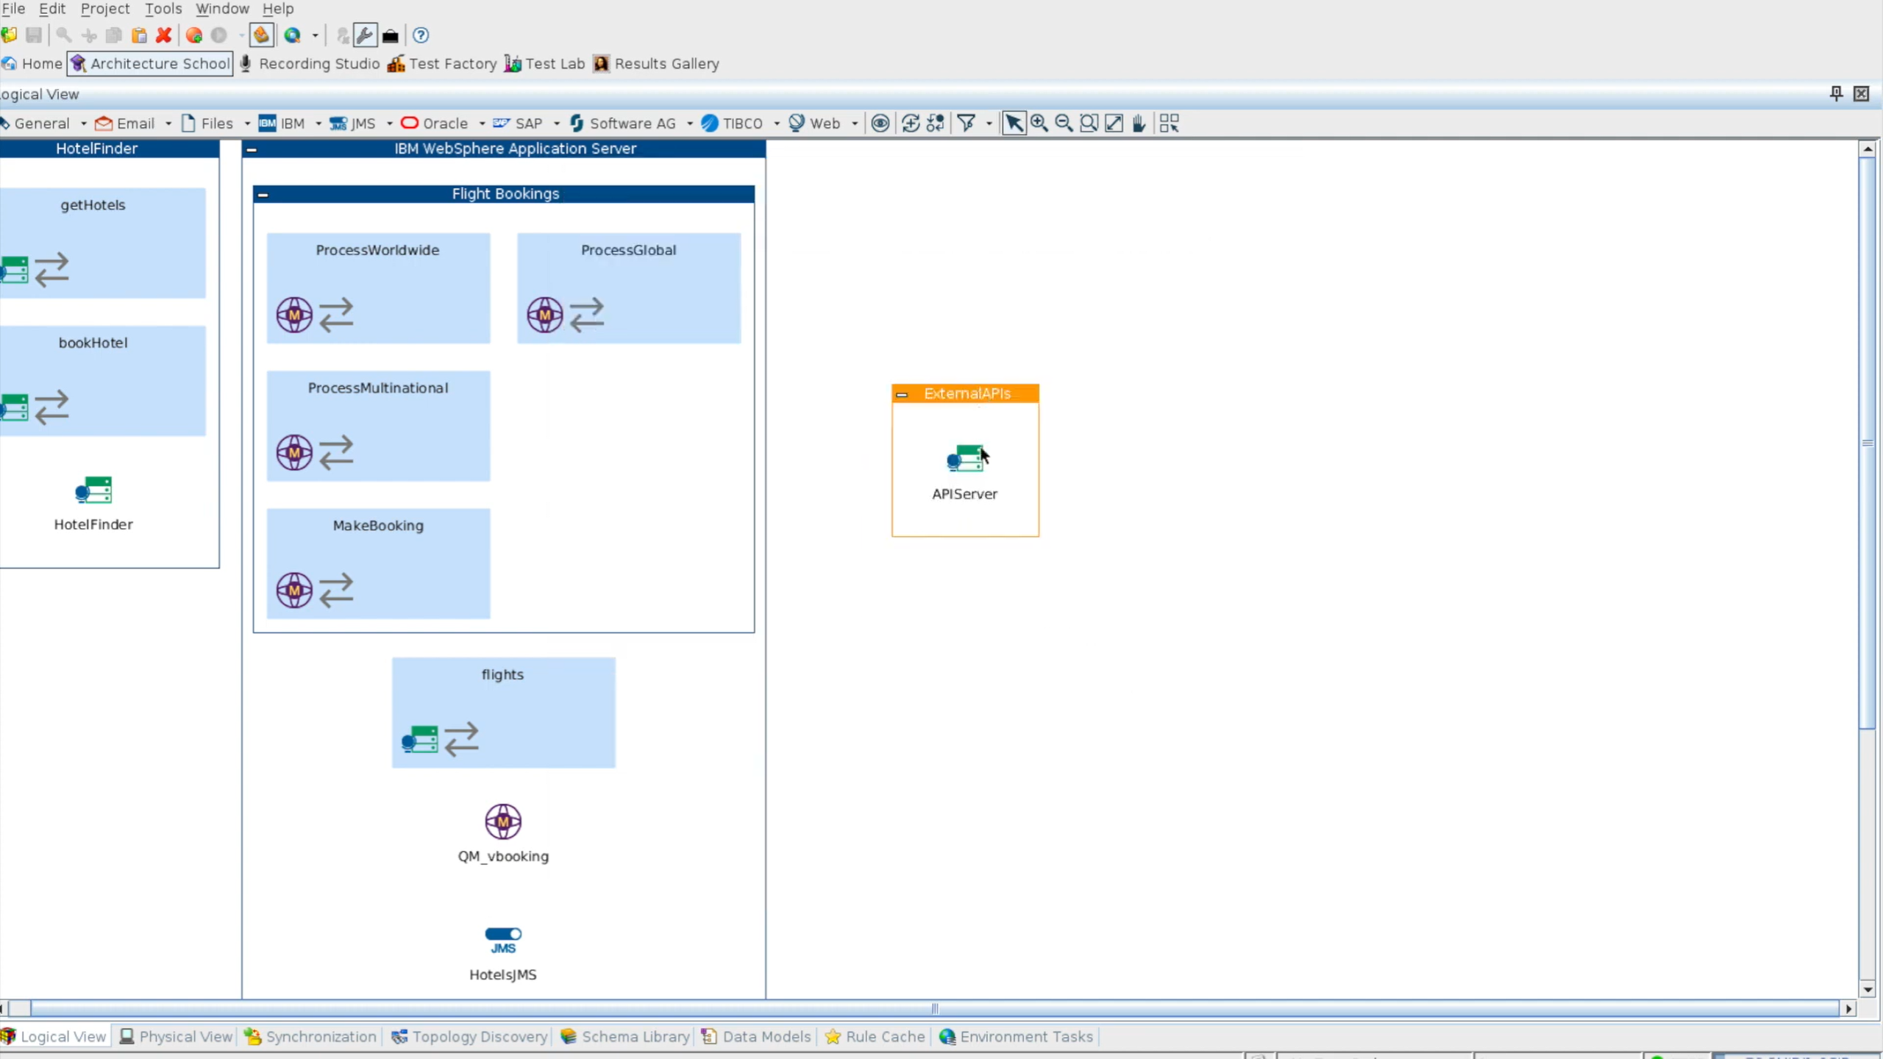

Slide 15
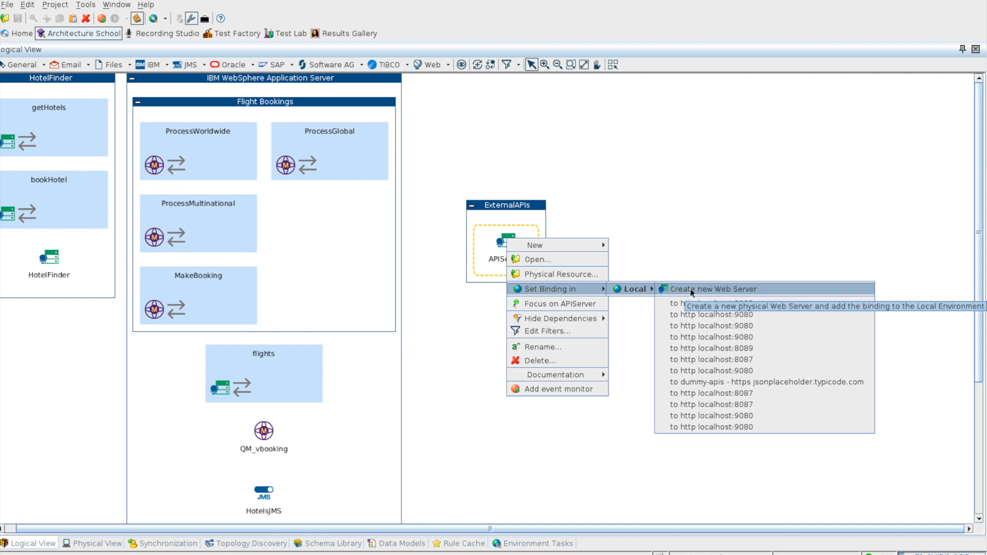

Slide 16
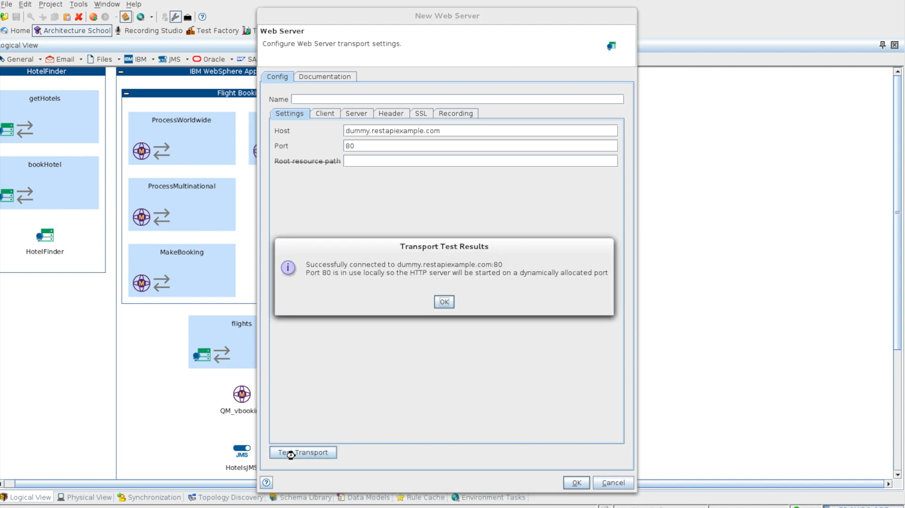

Slide 17
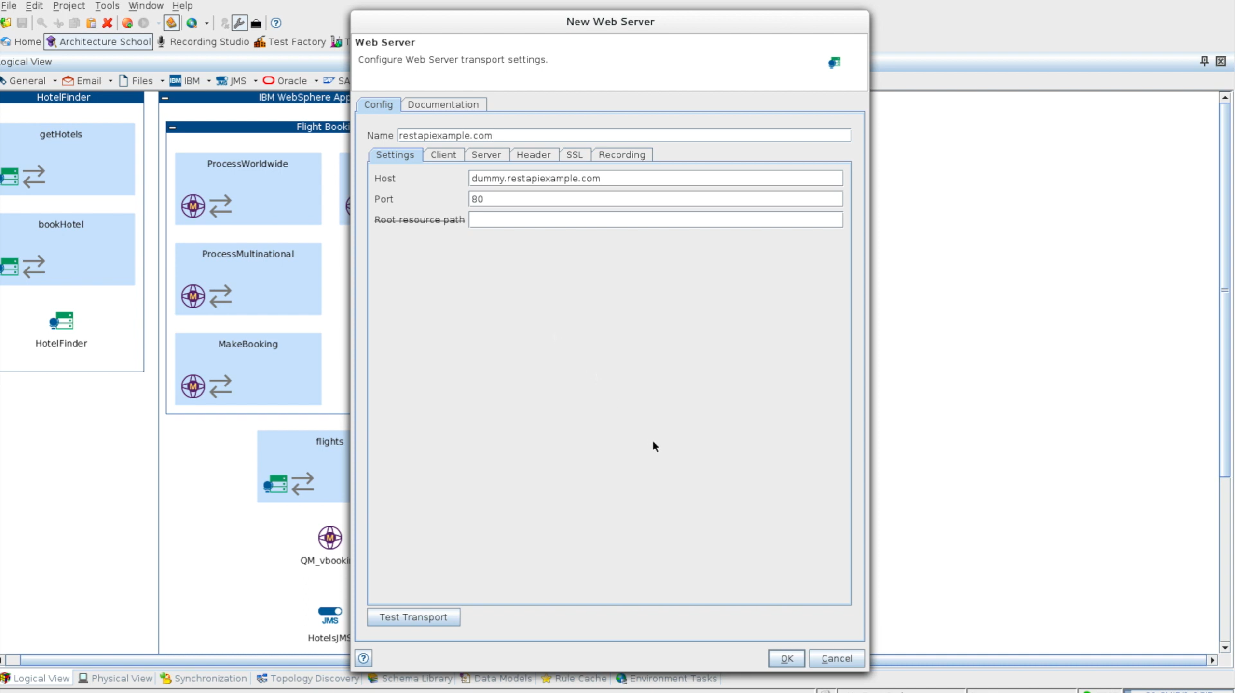

Slide 18
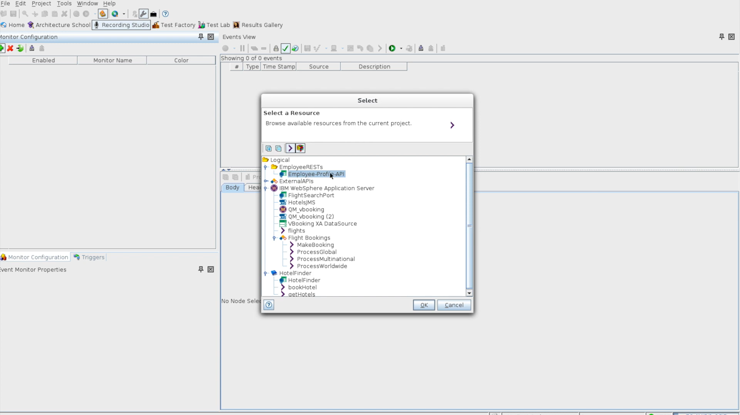

Slide 19
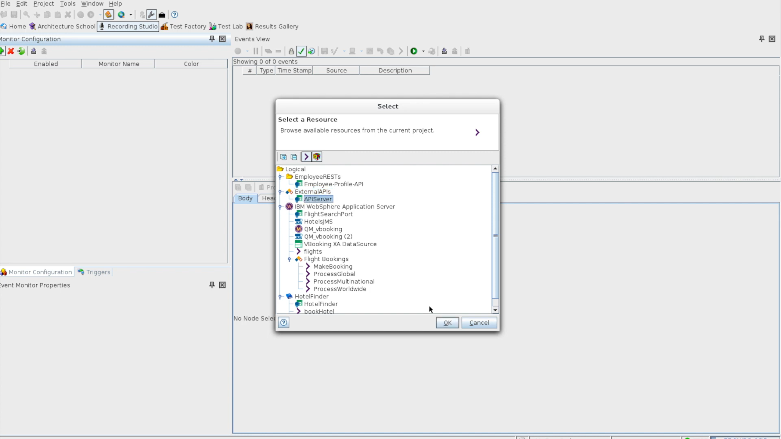

Slide 20
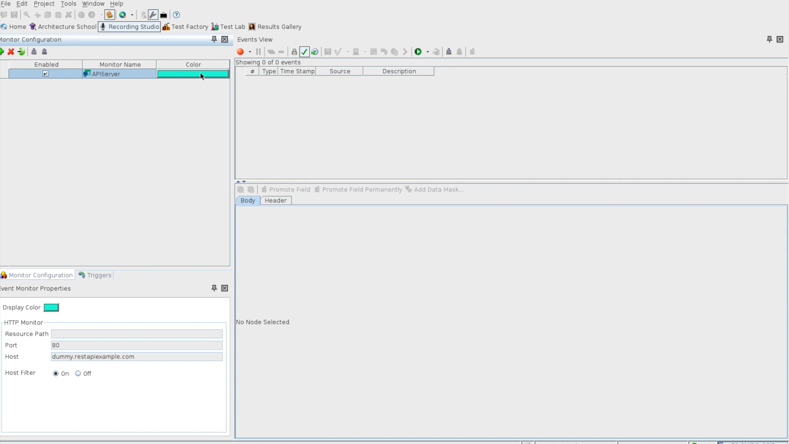
You can change
This color, when you have multiple servers/tests/scripts

Slide 21
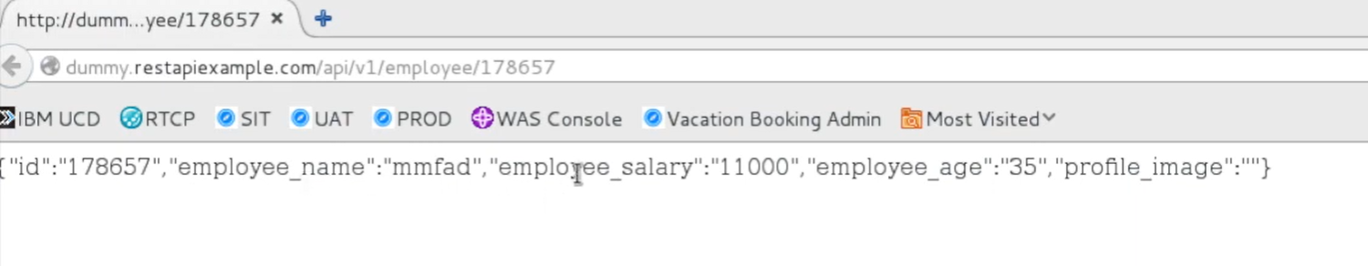

Slide 22
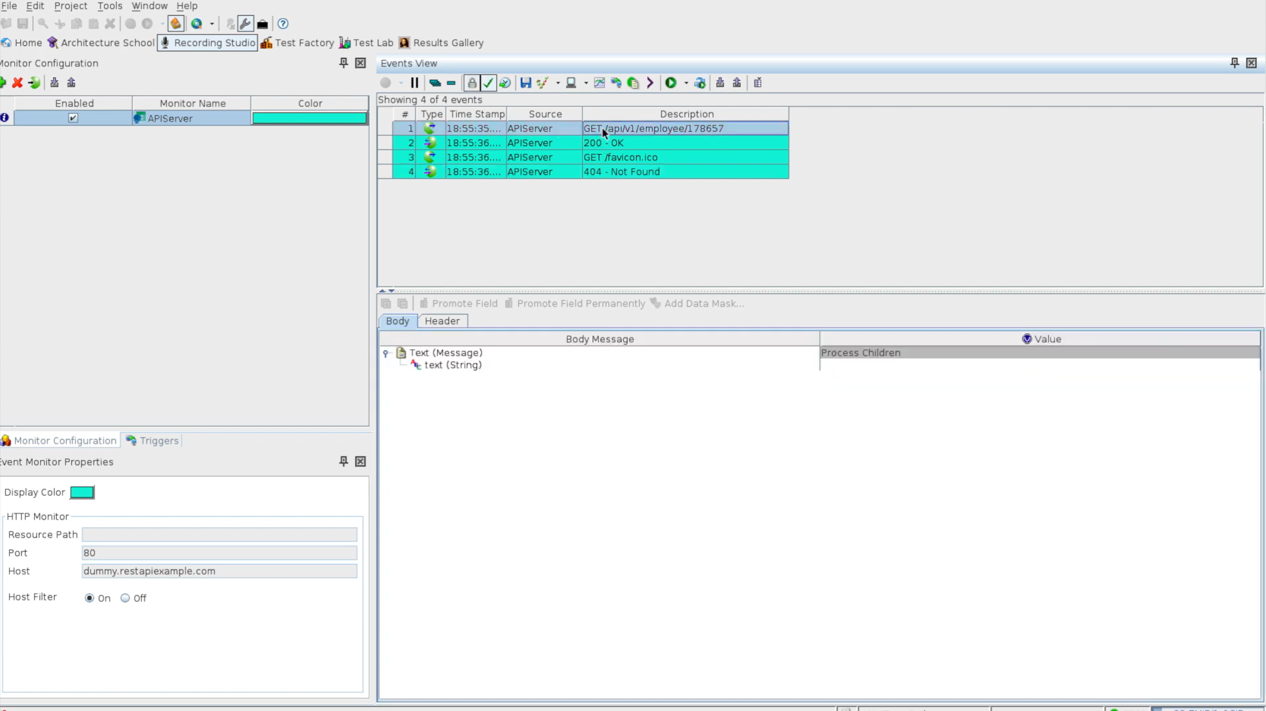

Slide 23
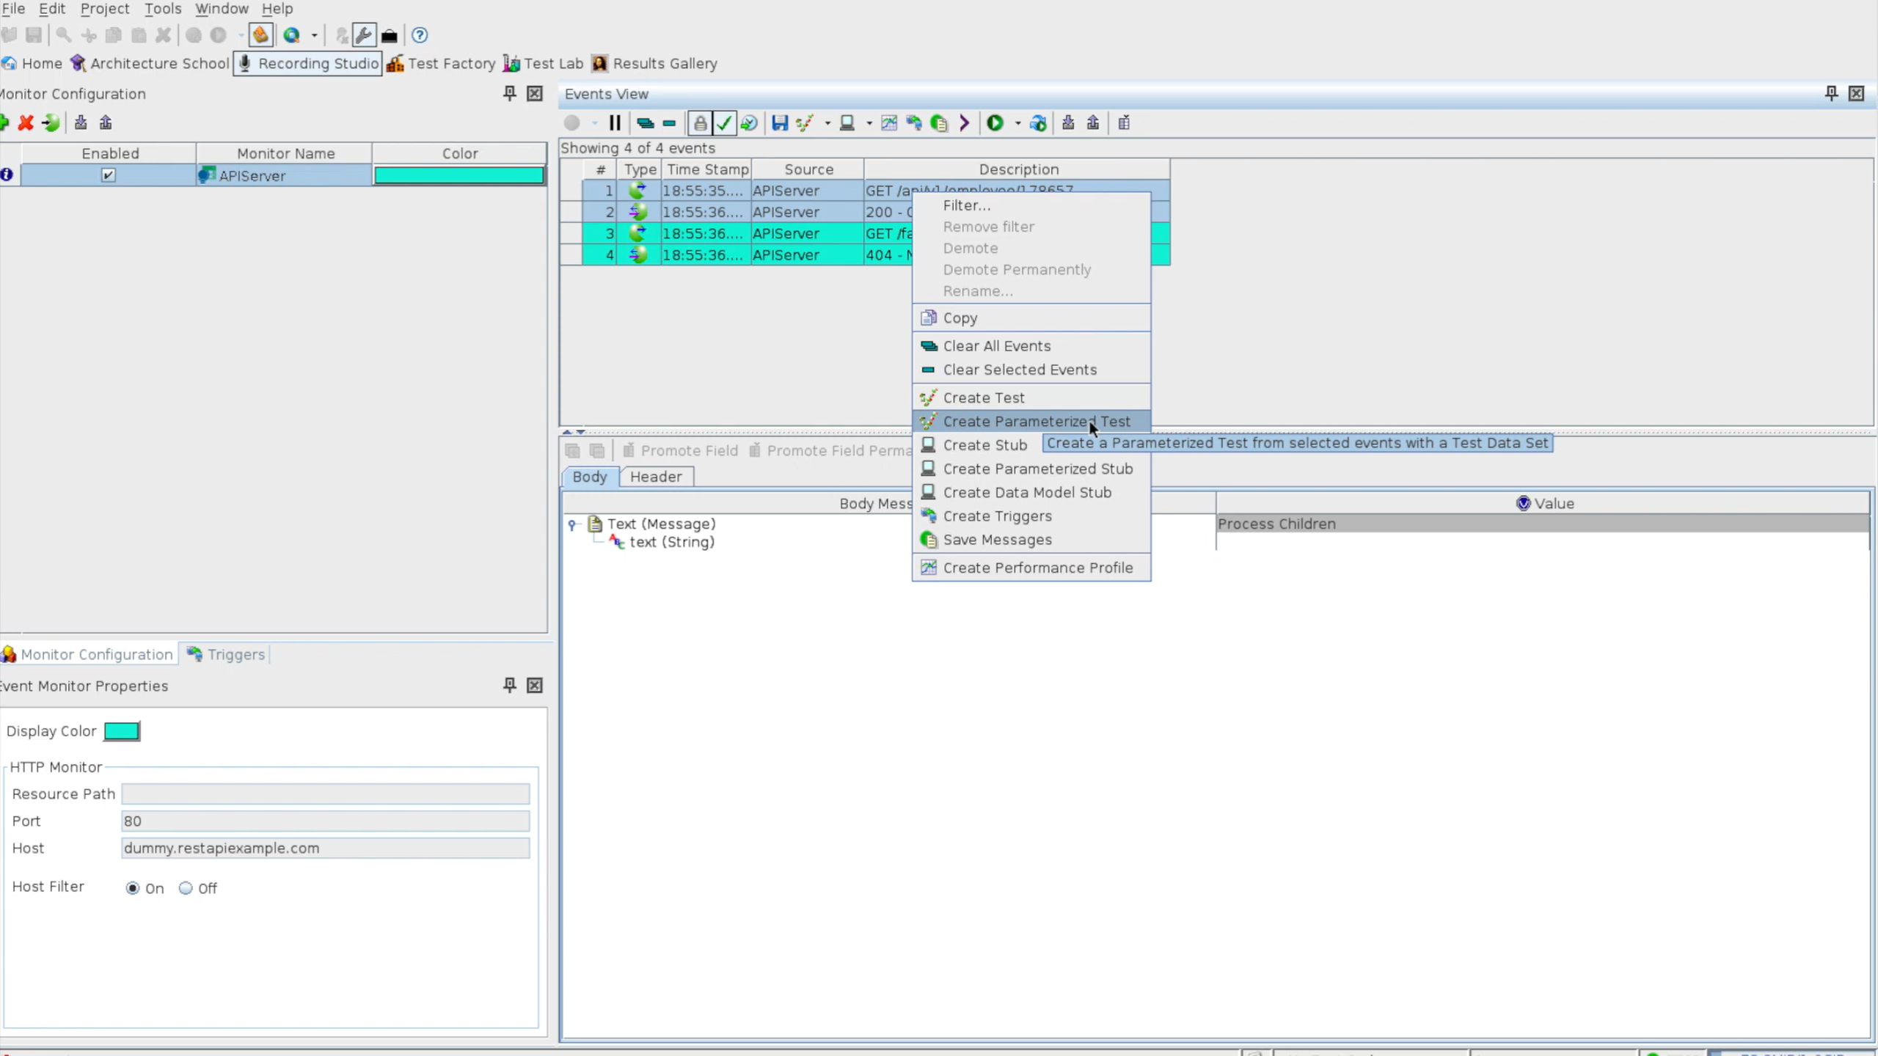

Slide 24
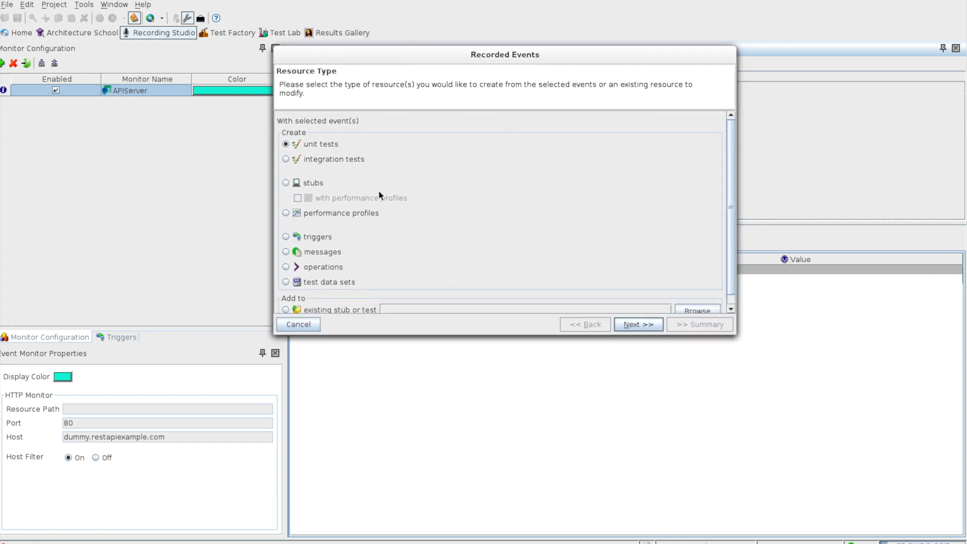
We have selected
“Create test”

Slide 25
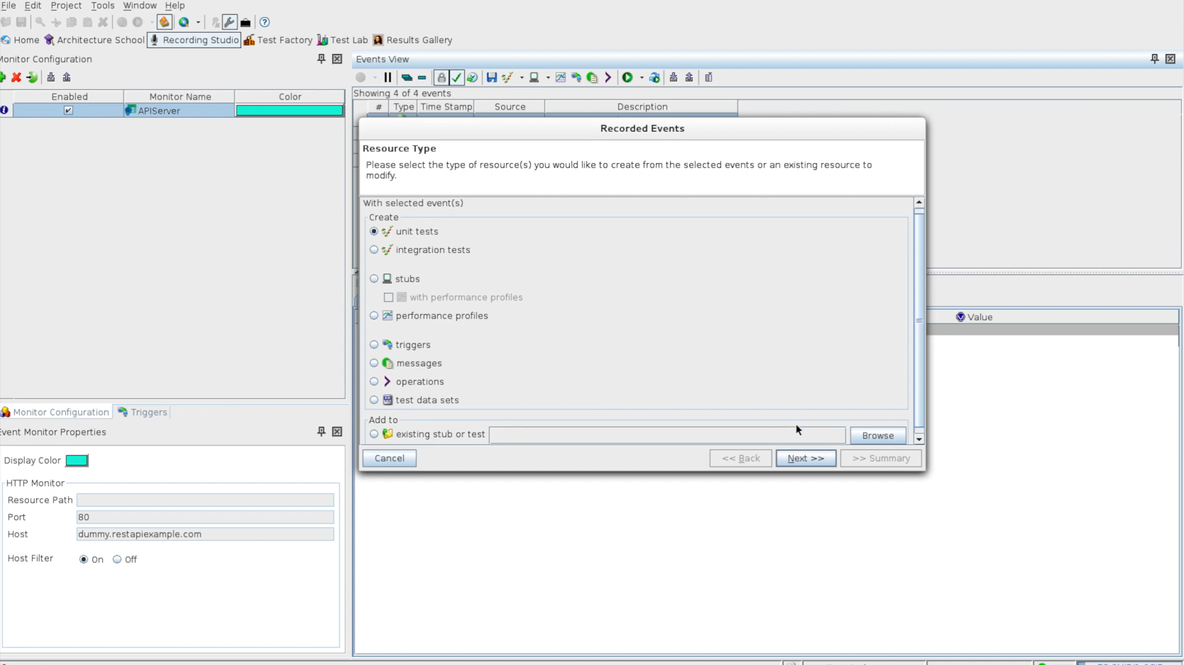
Select unit test
Next>>

Slide 26
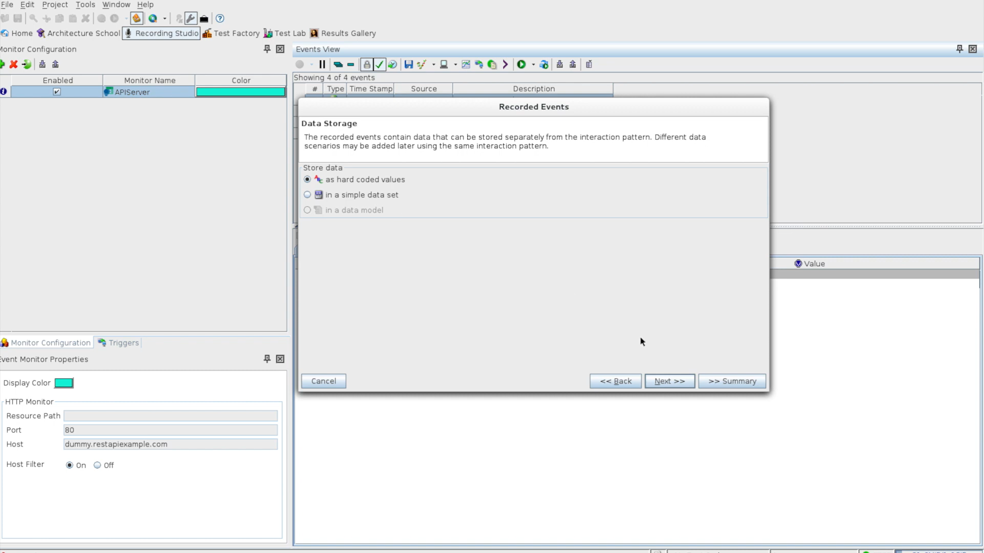
Select Hardcoded
Values
Next>>

Slide 27
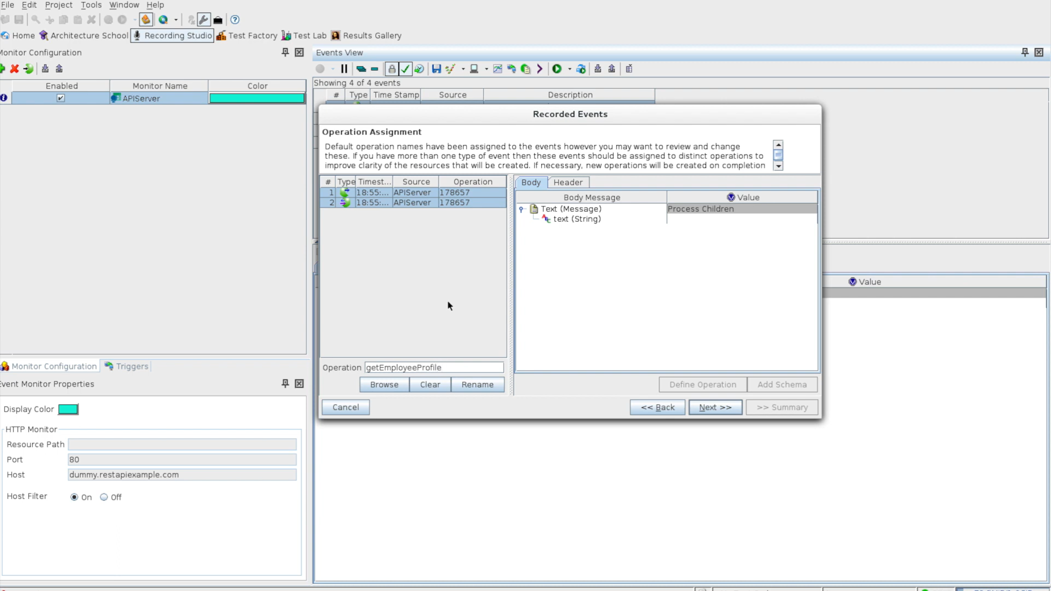
Rename

Slide 28
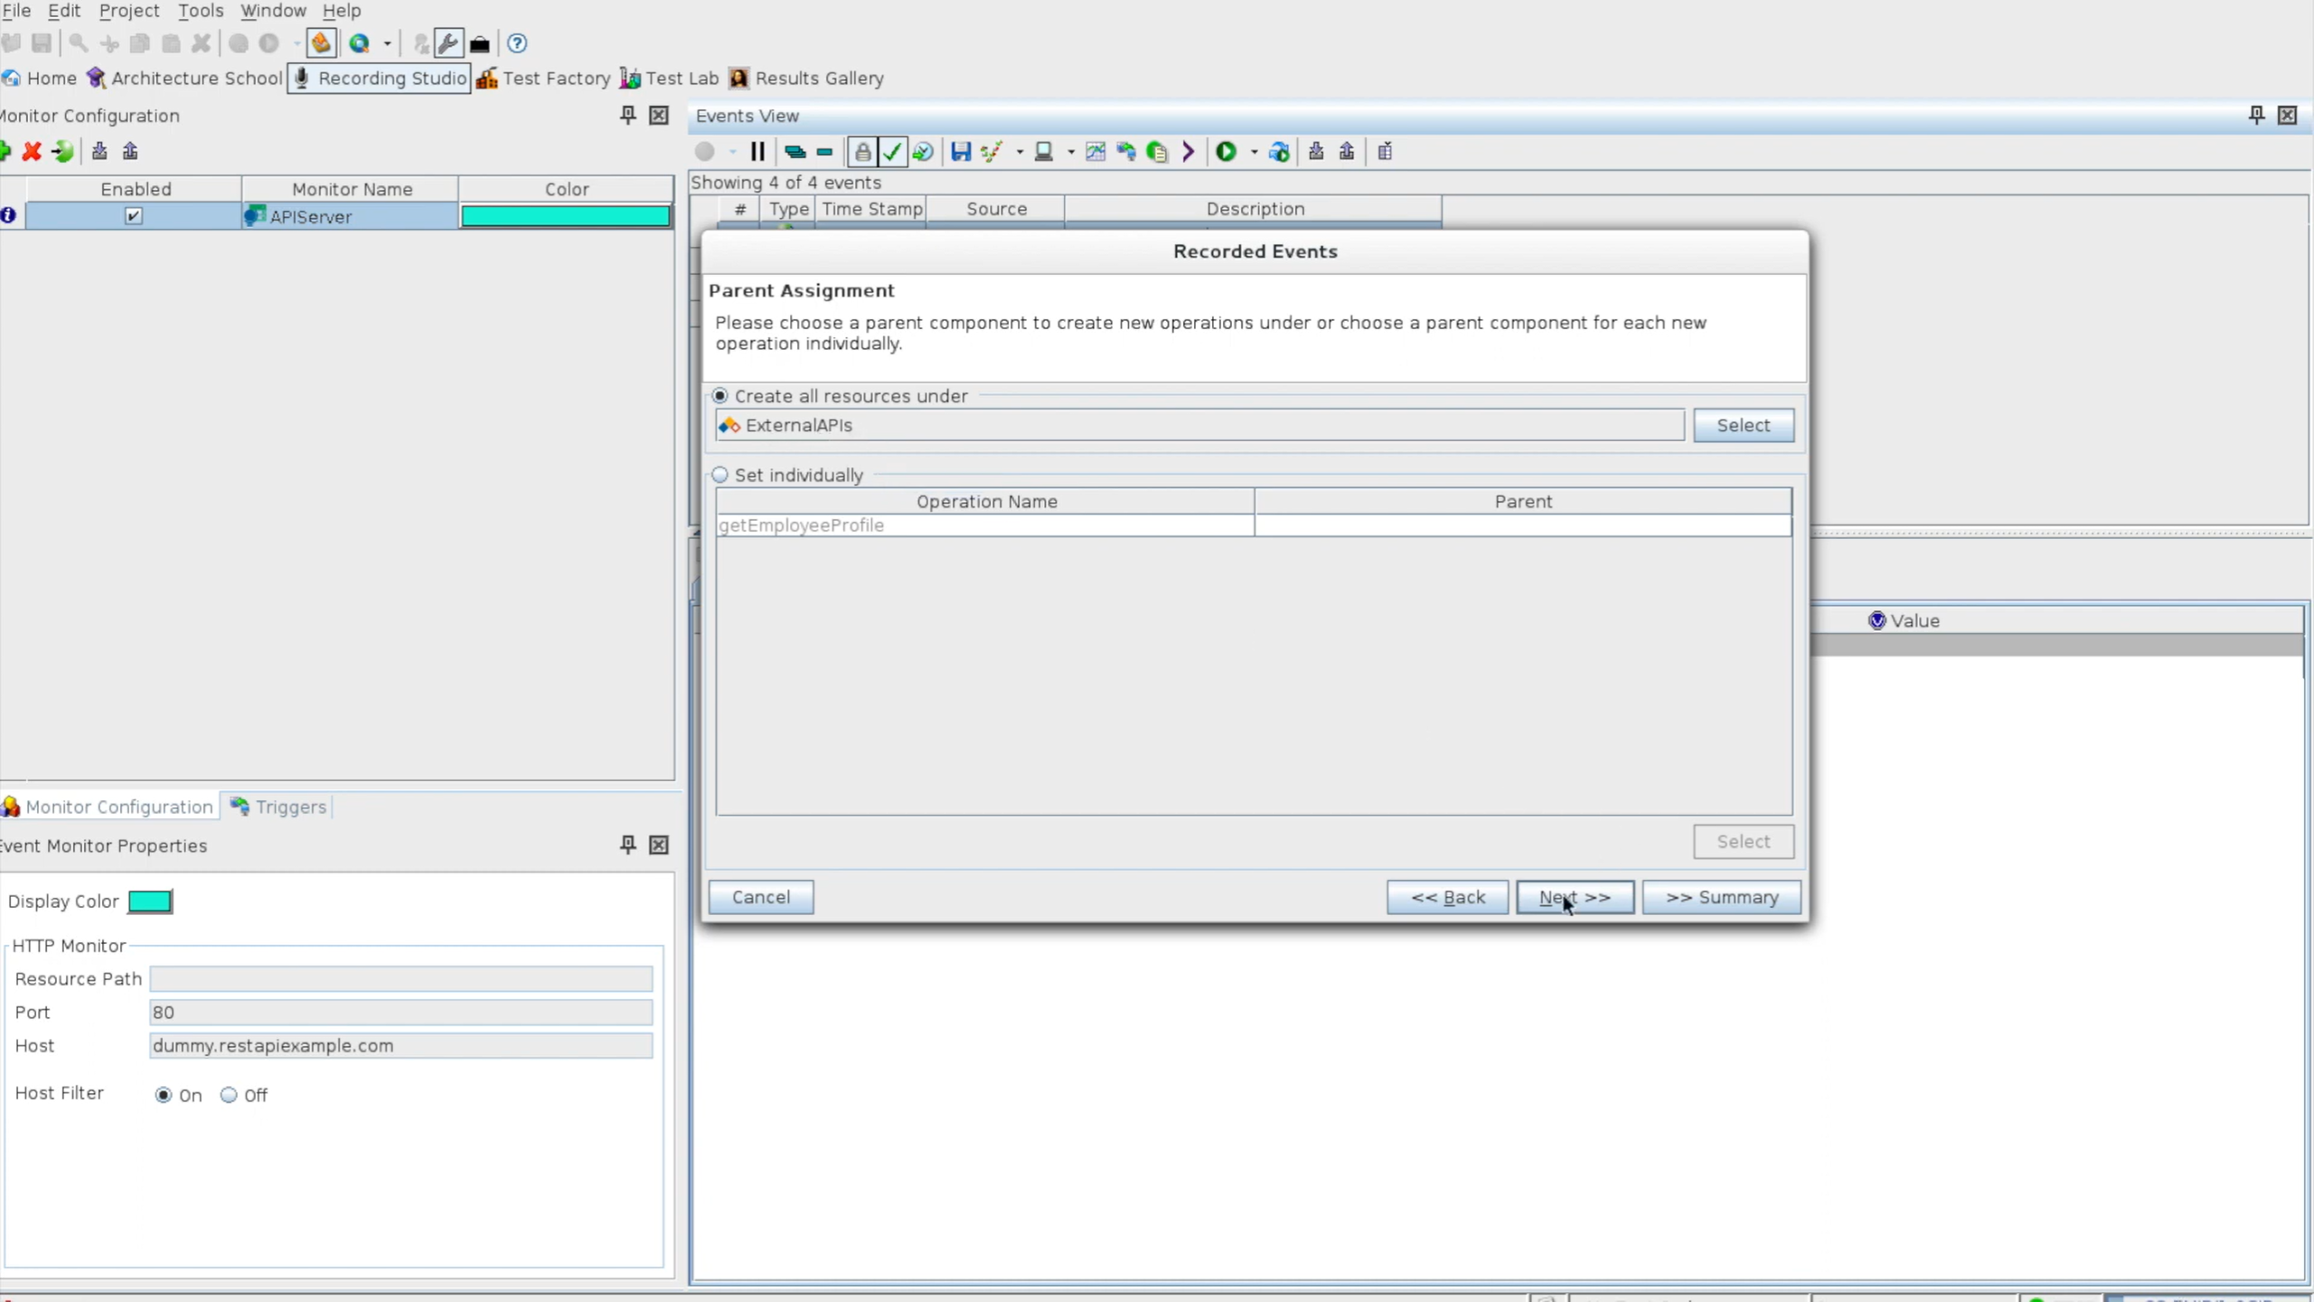

Slide 29
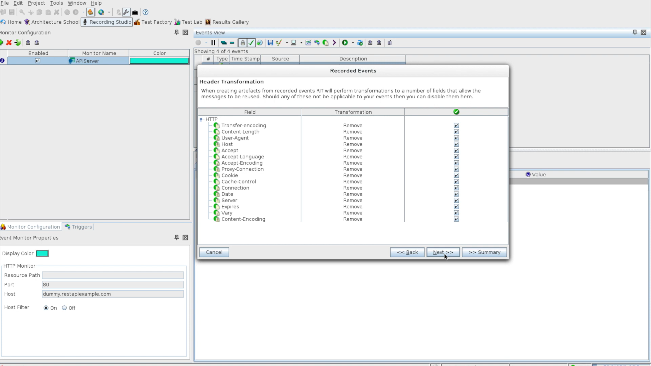

Slide 30
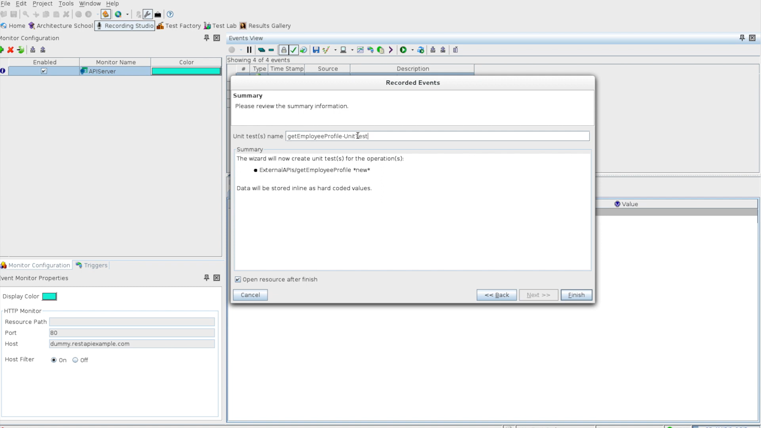

Slide 31
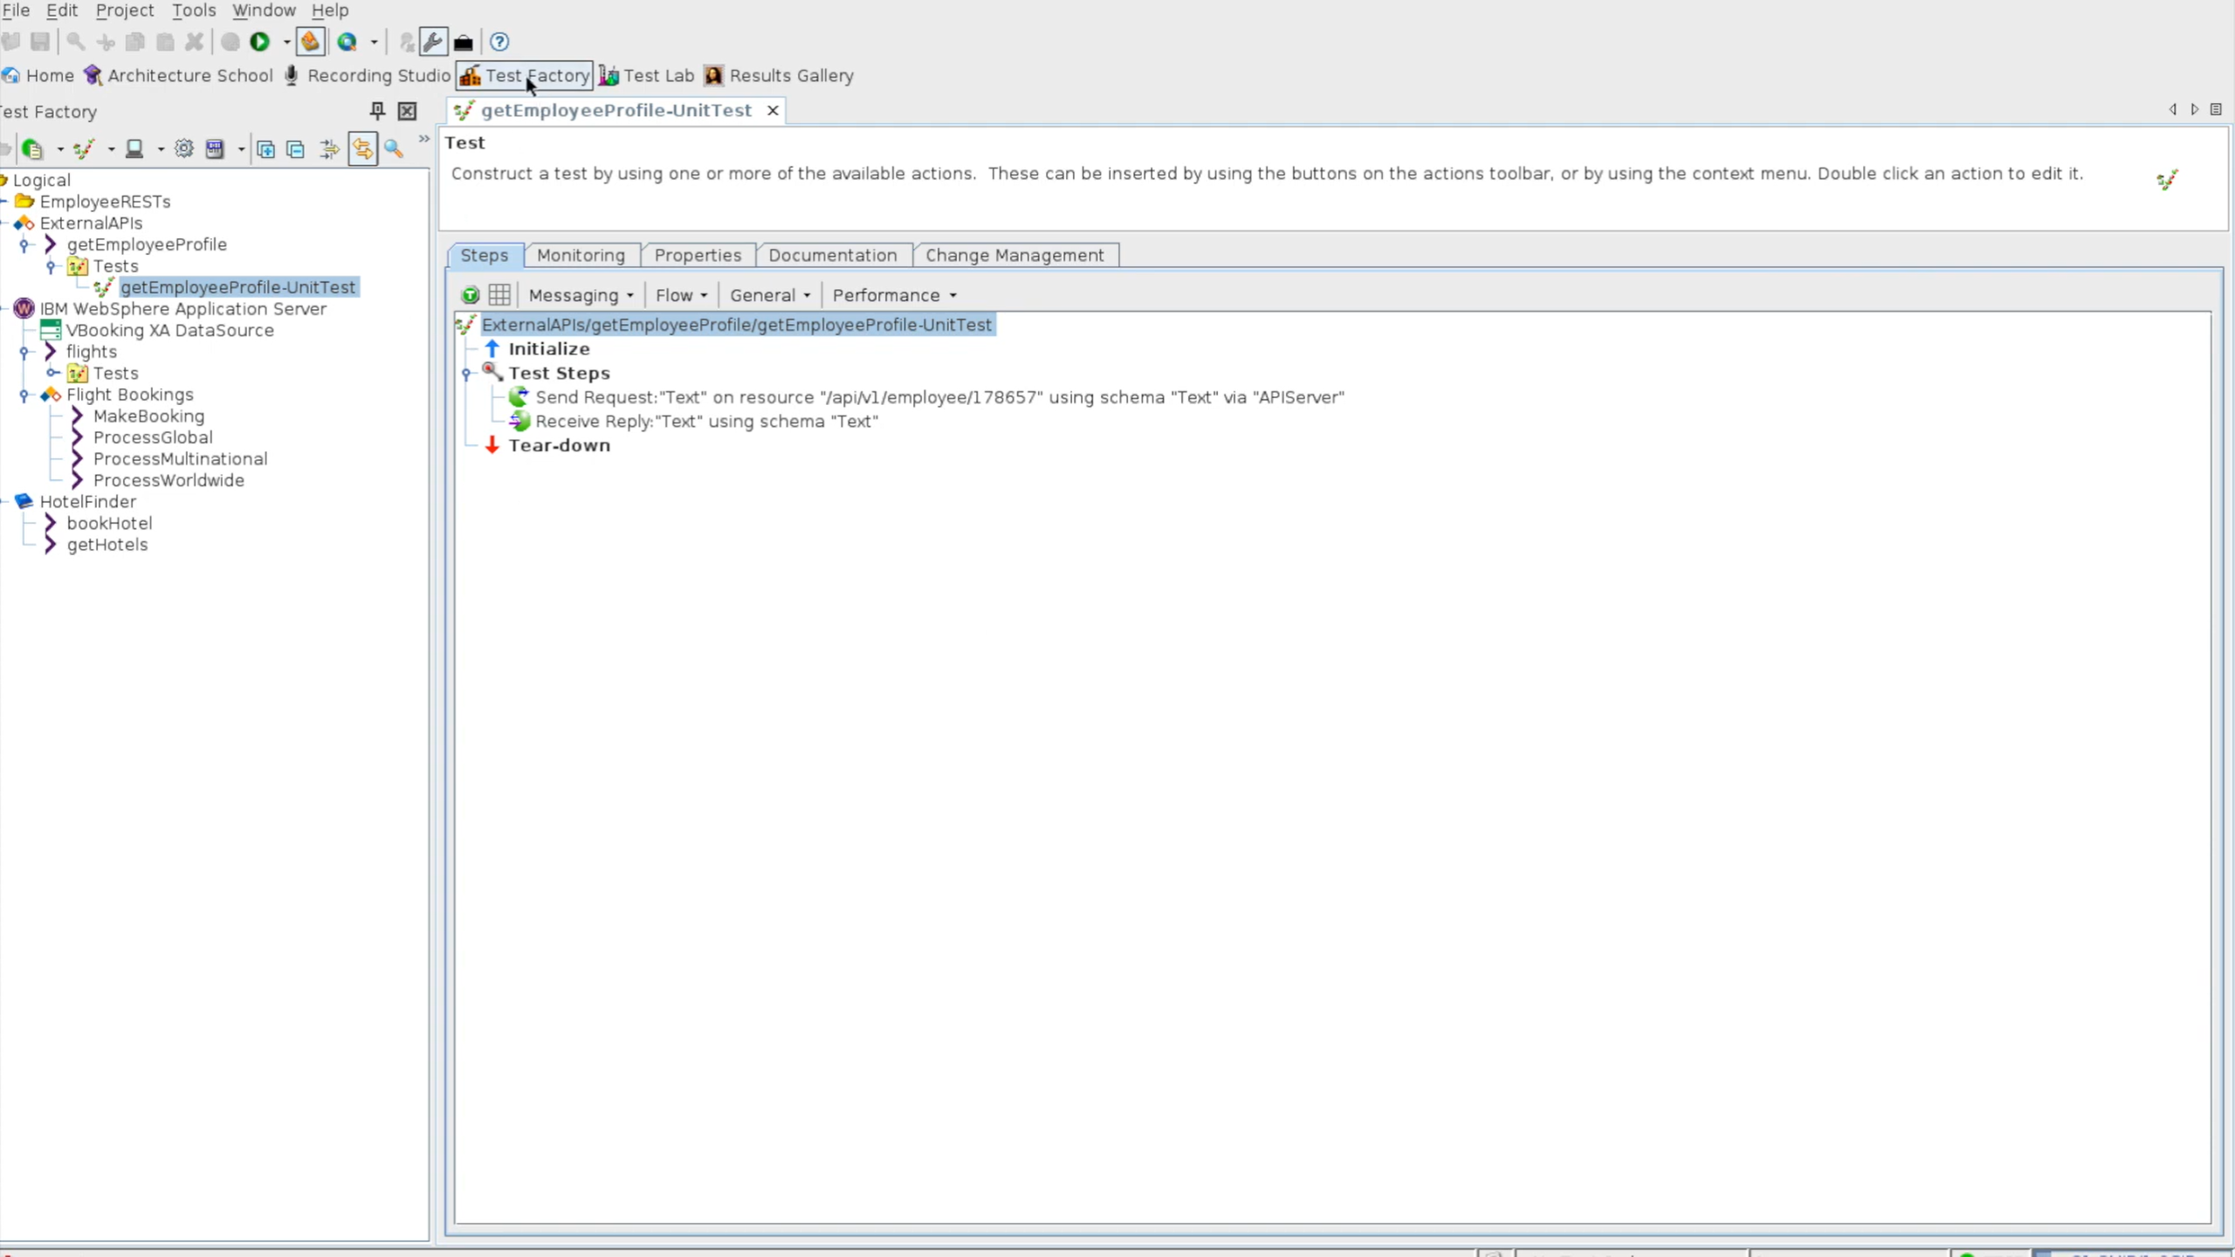

Slide 32
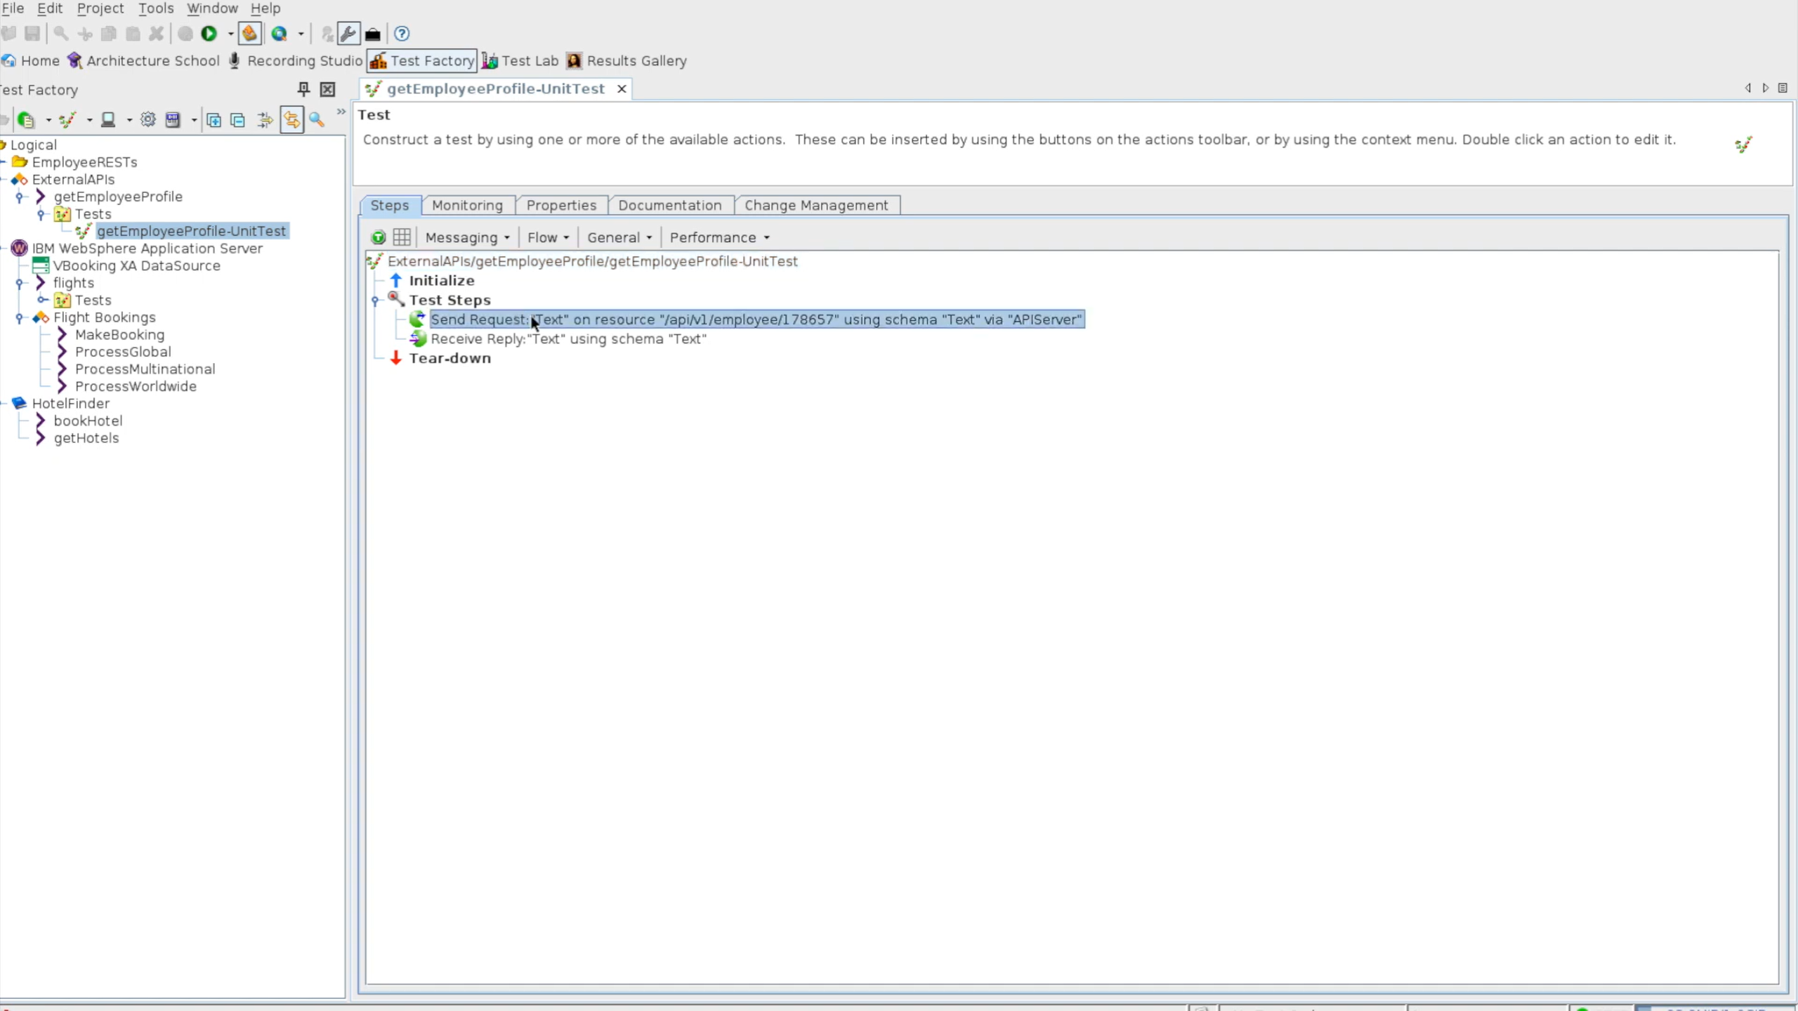
Customize

Slide 33
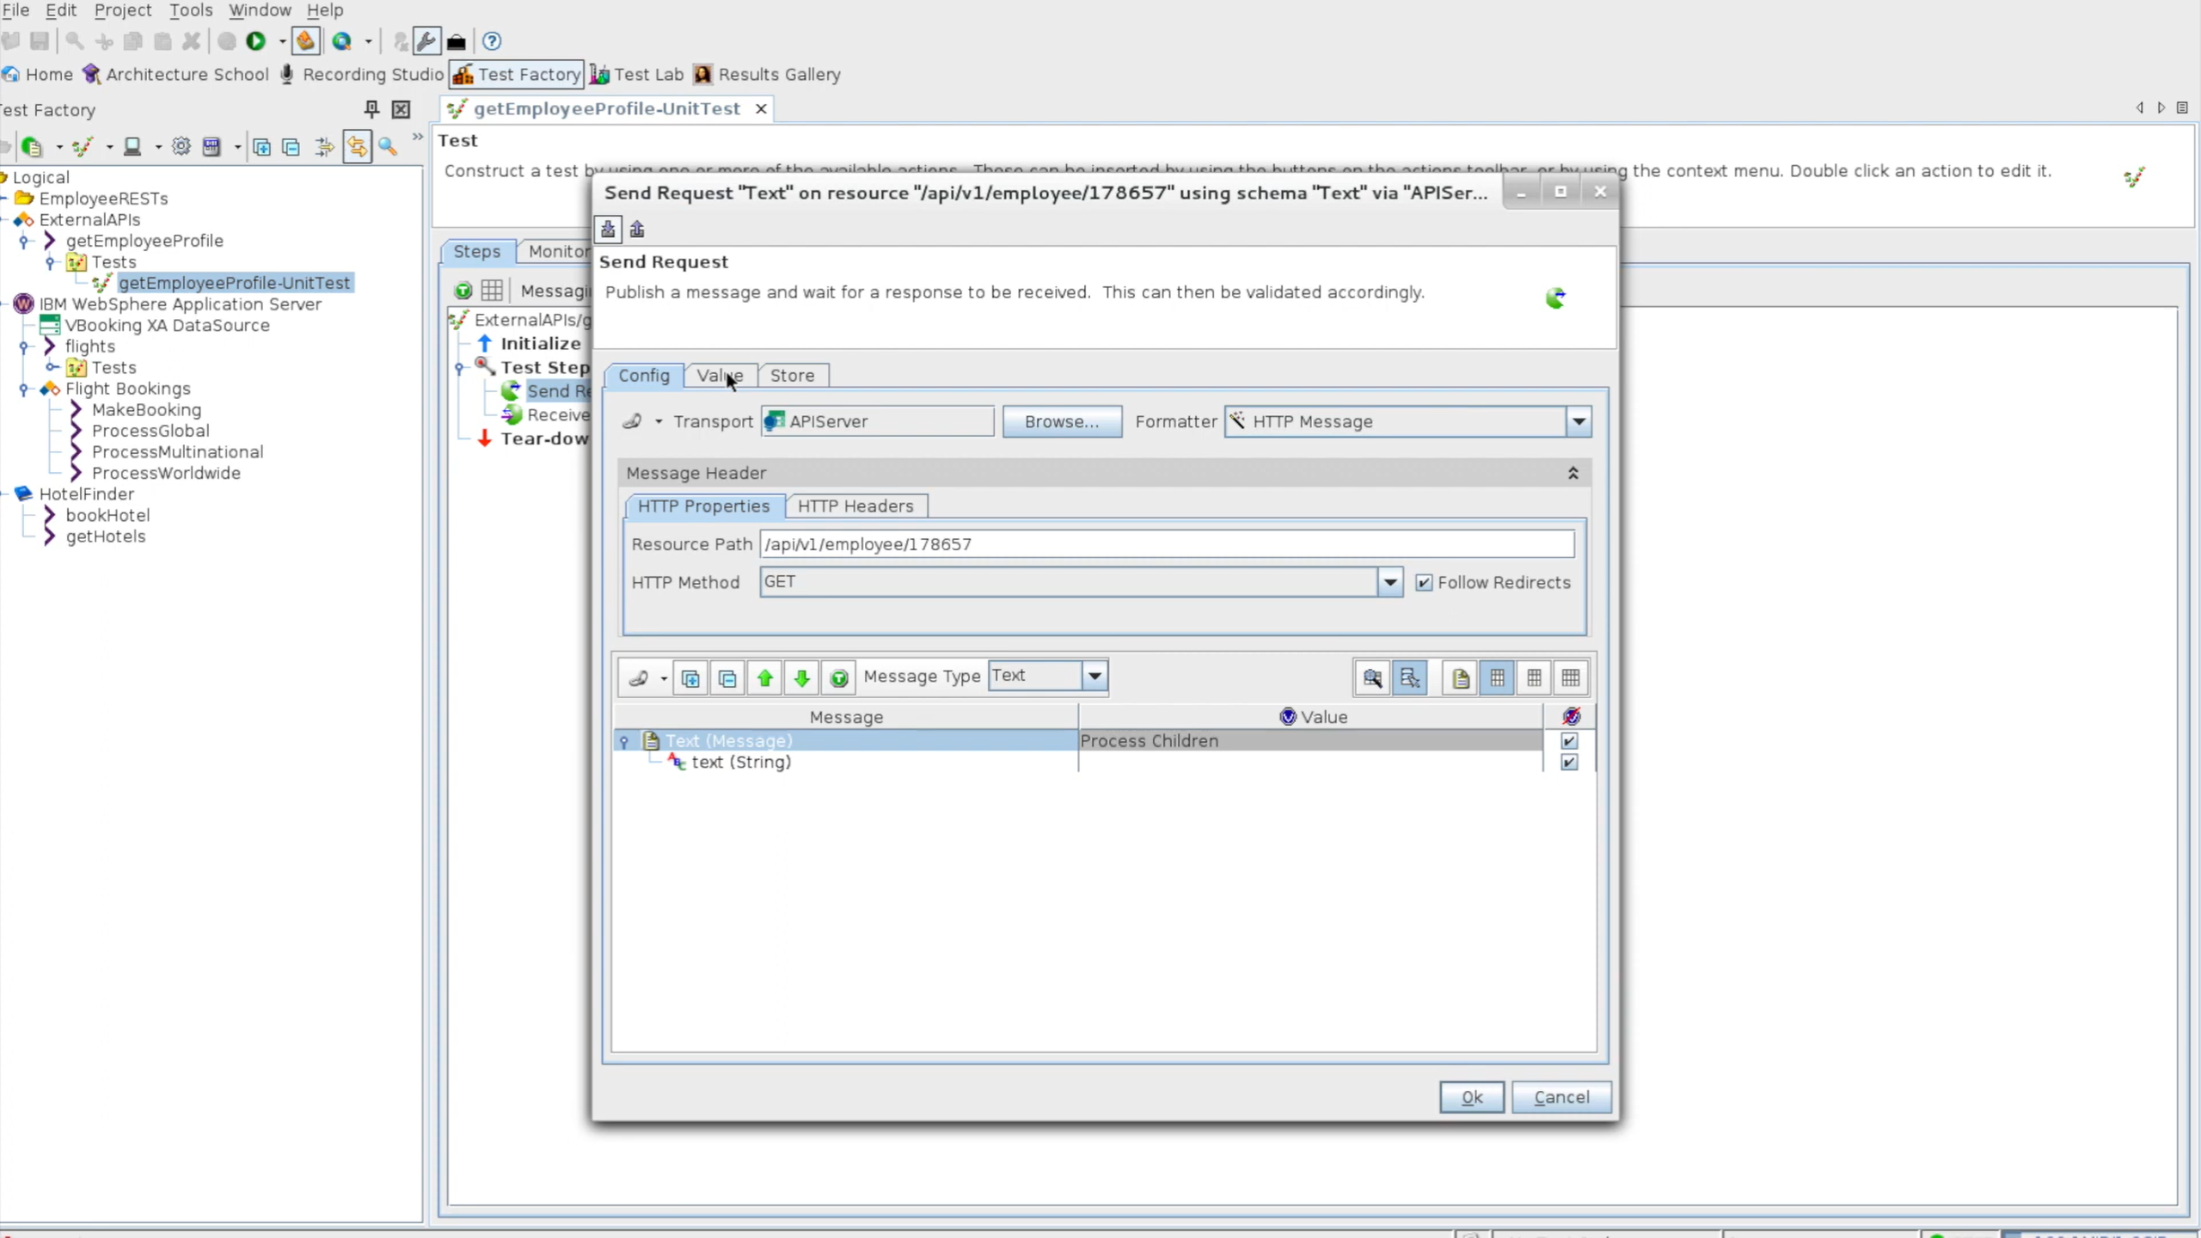

Slide 34
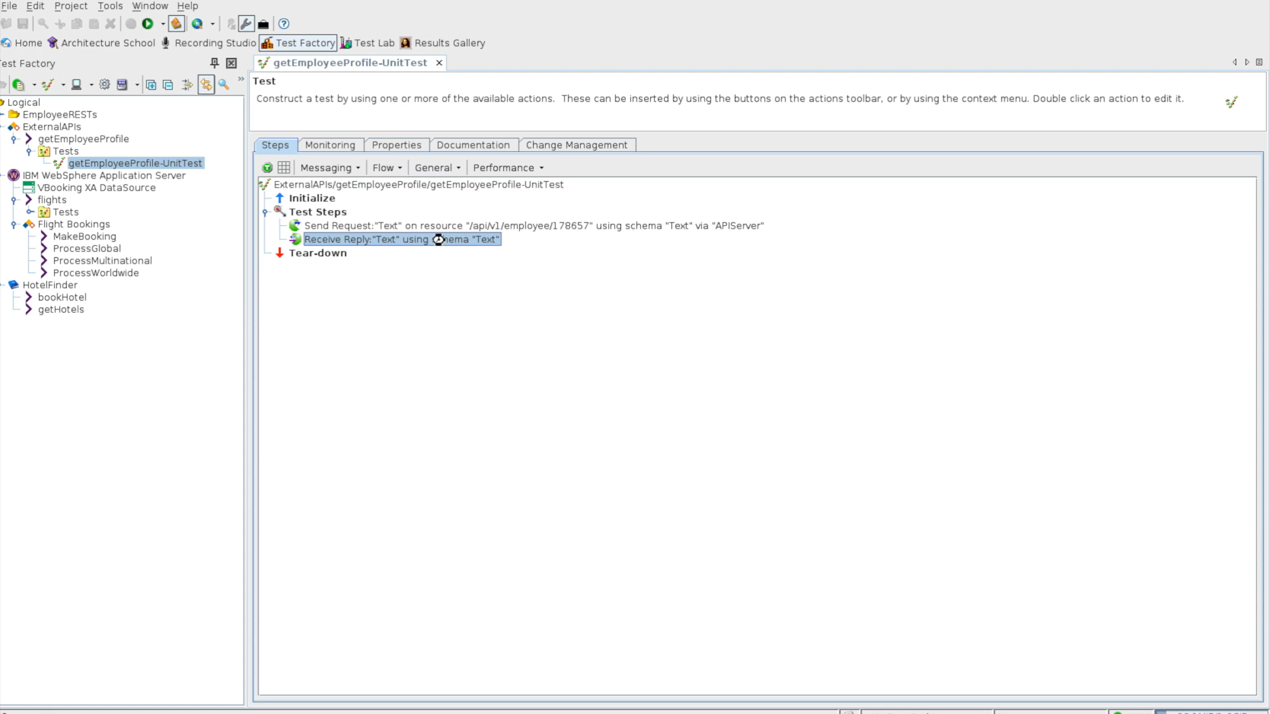

Slide 35
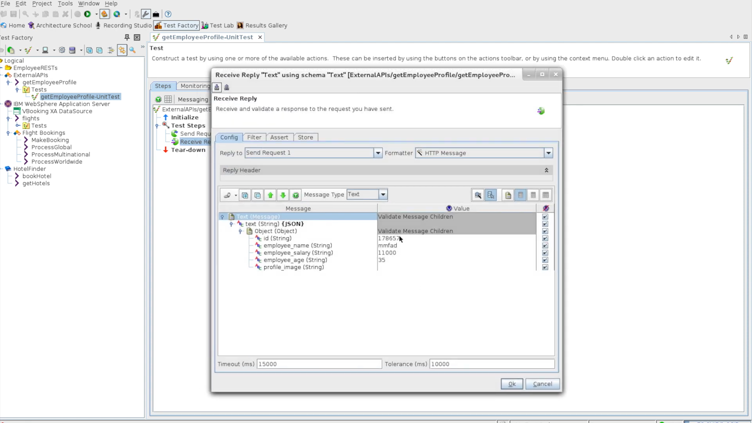

Slide 36
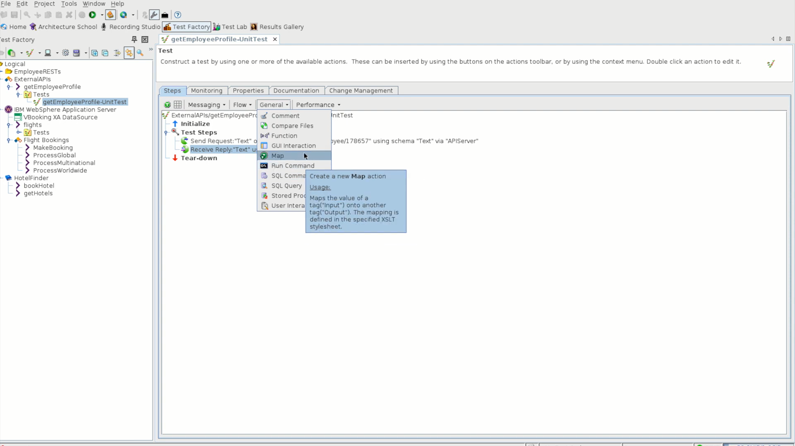

Slide 37
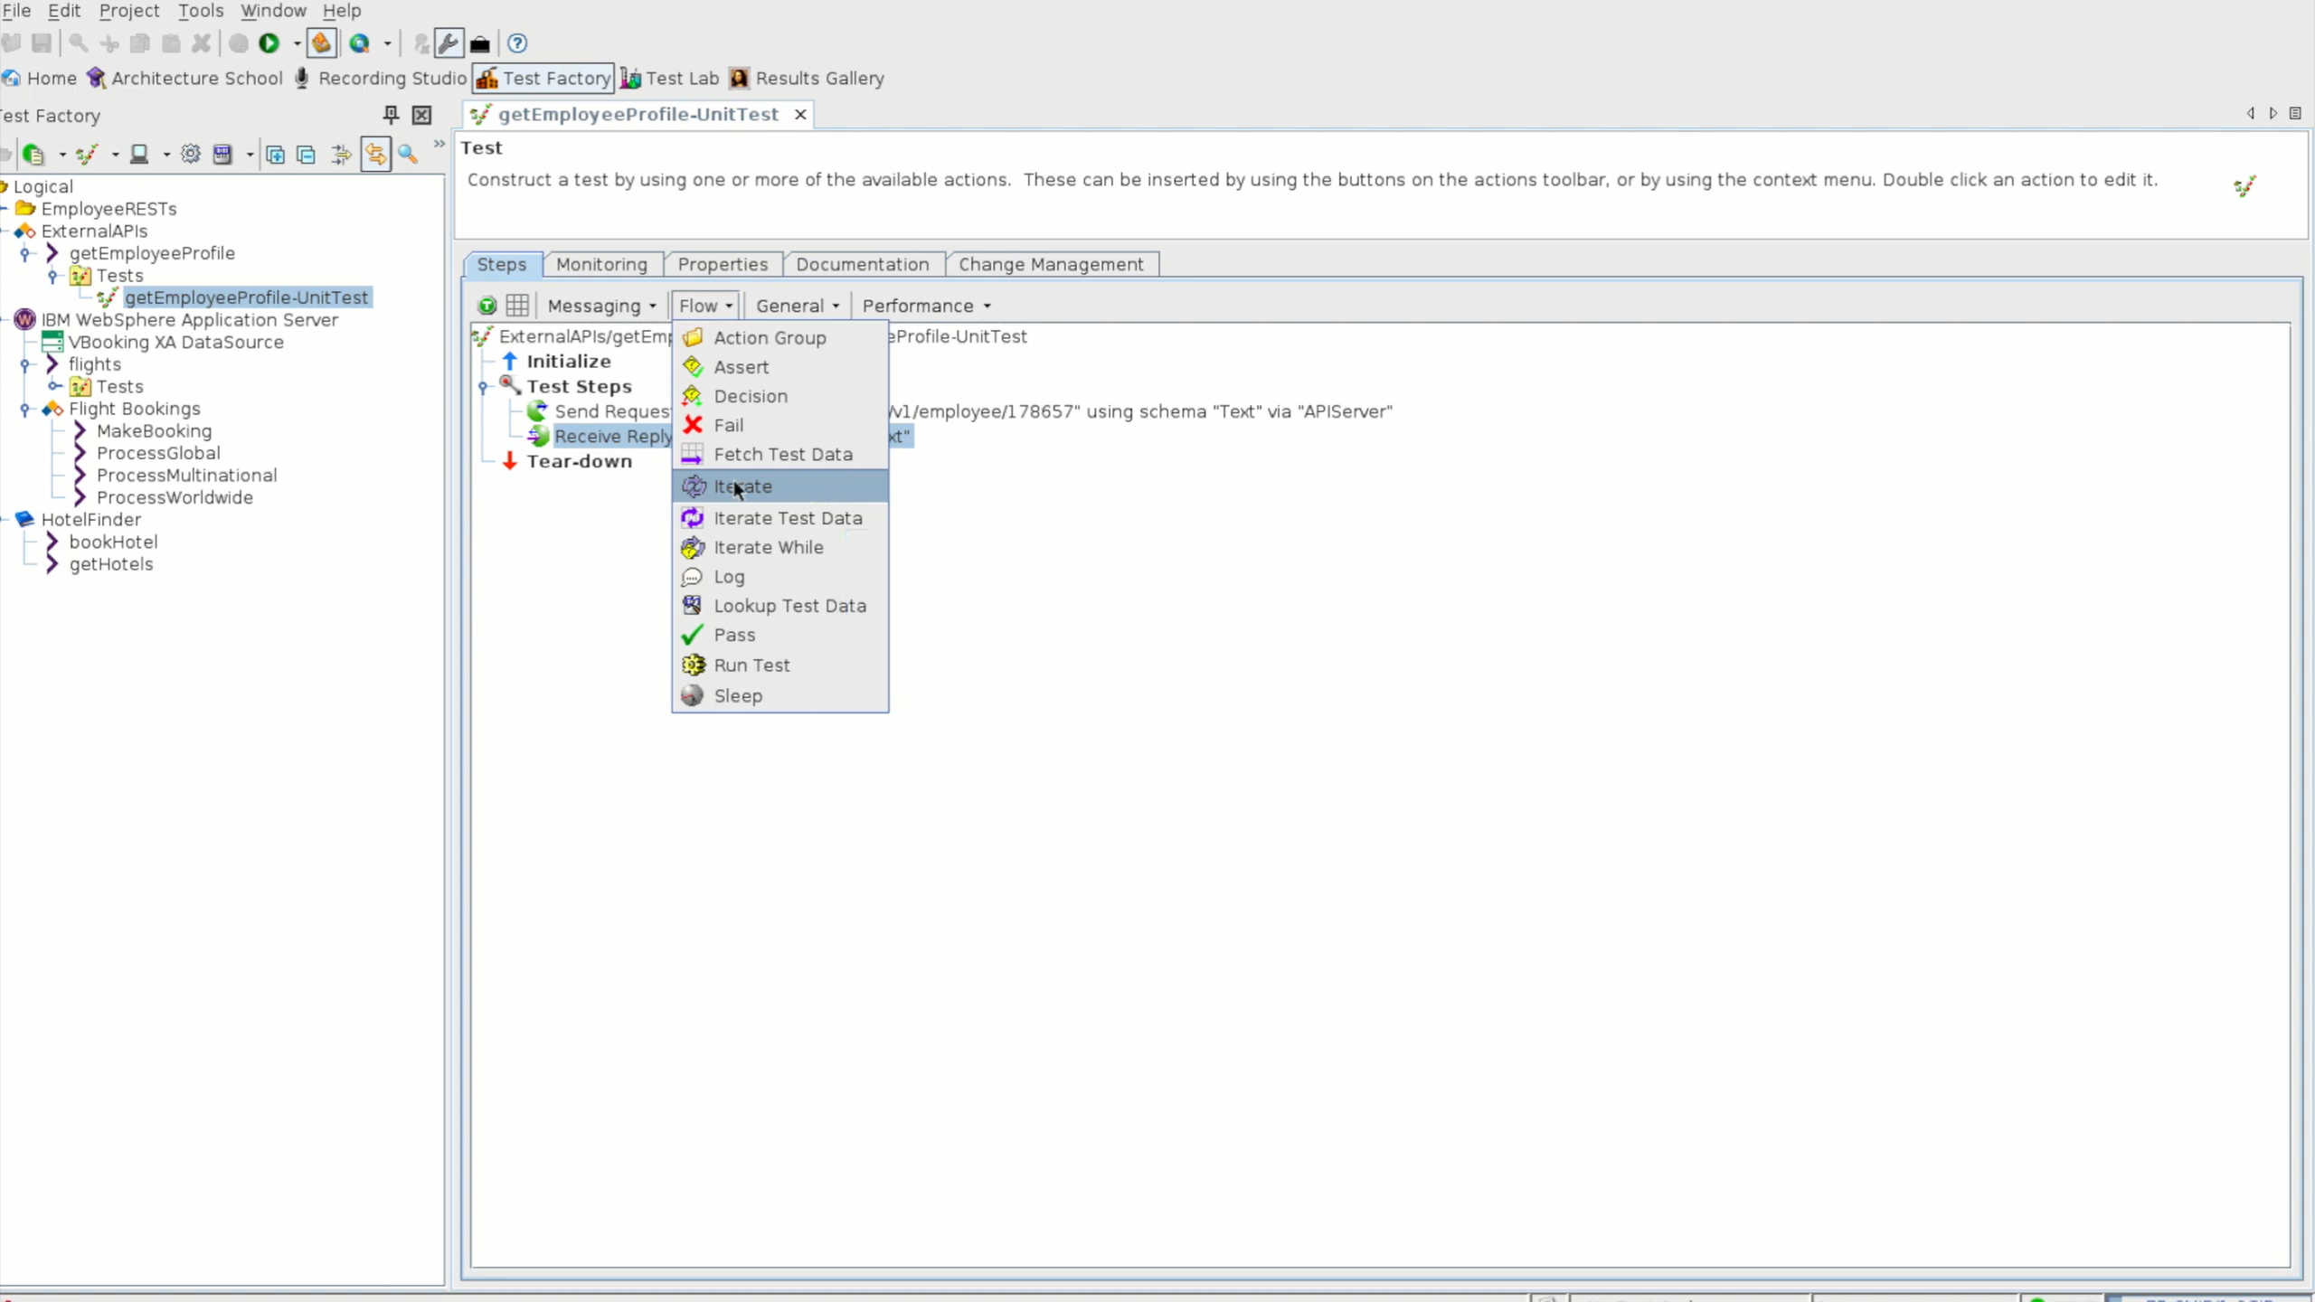

Slide 38
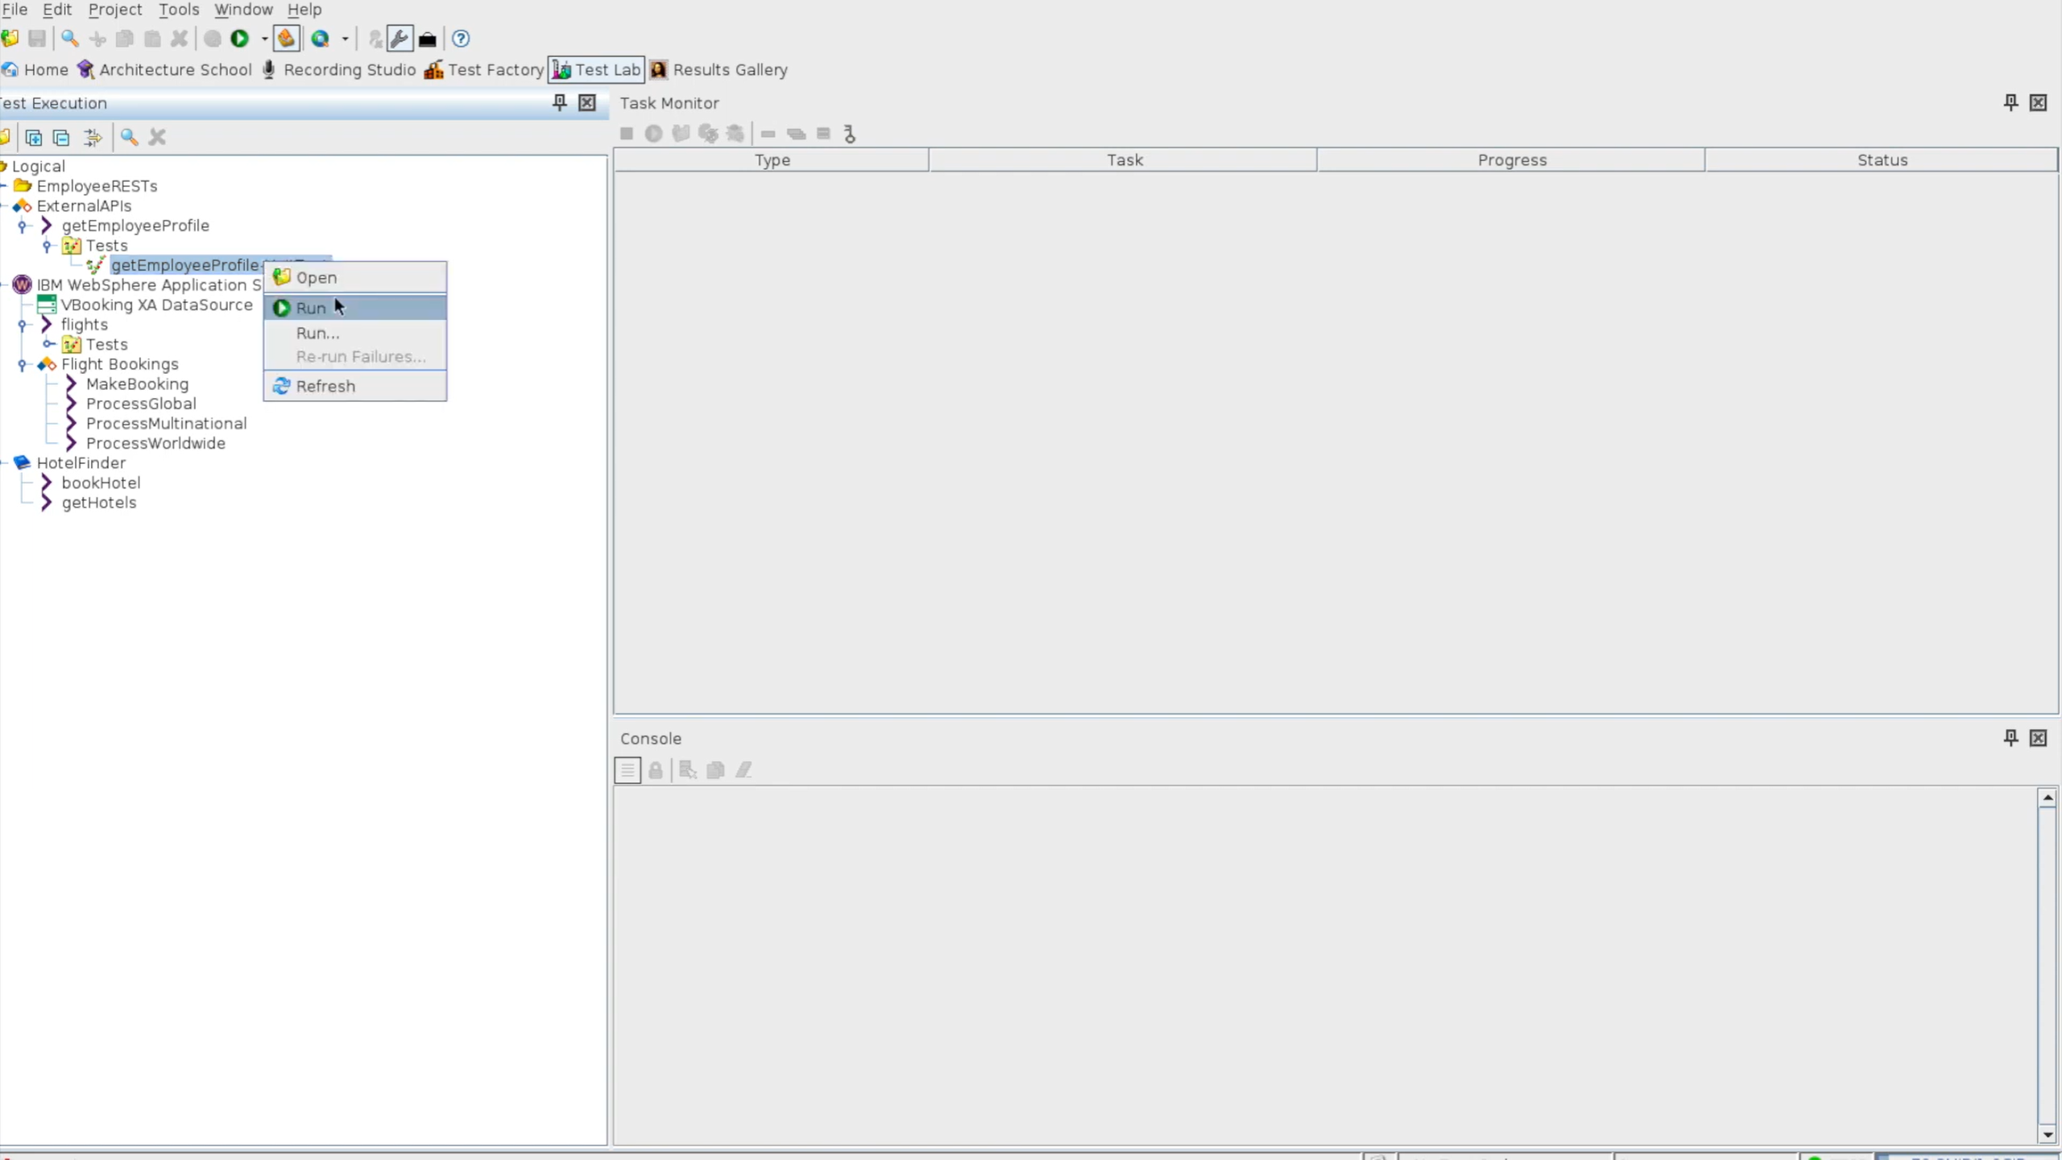

Slide 39
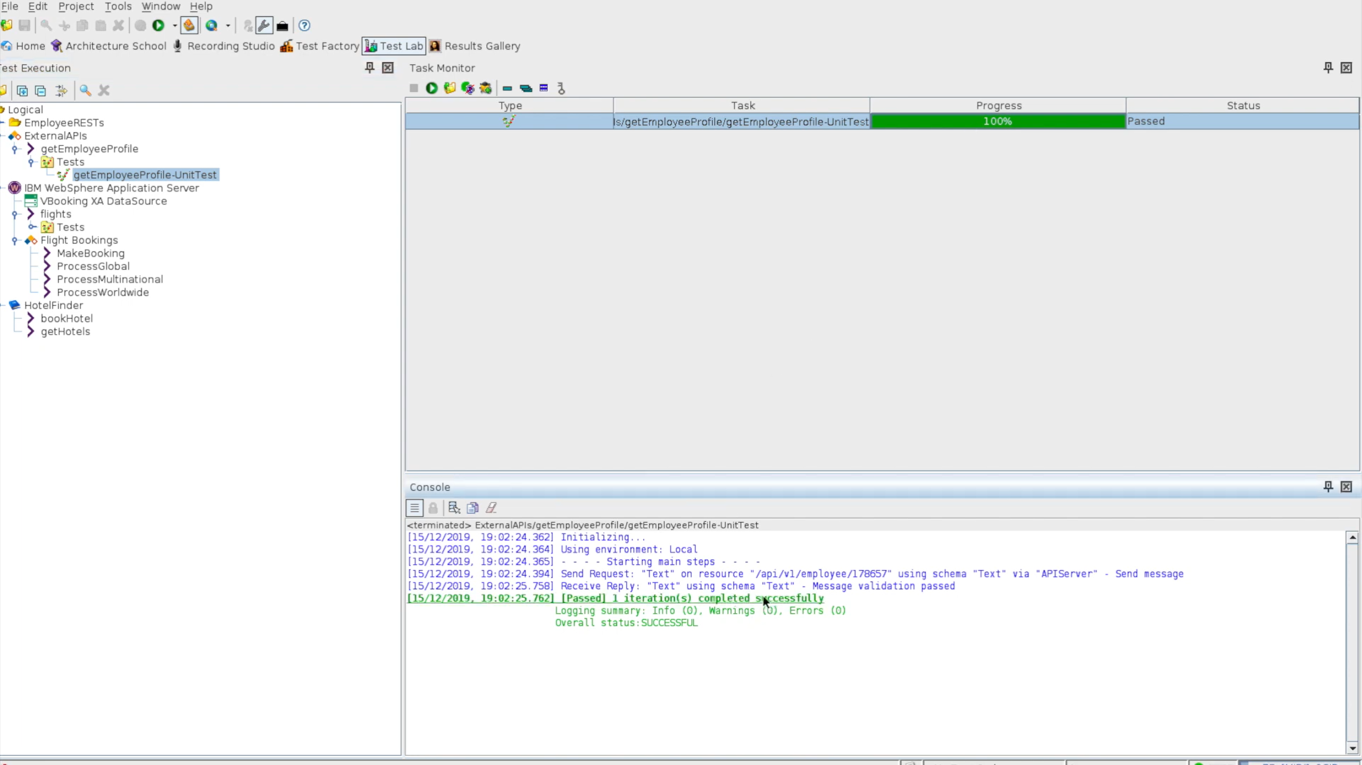
RIT in RTW calls the Api created
Dbl click
We can see logs in console

Slide 40
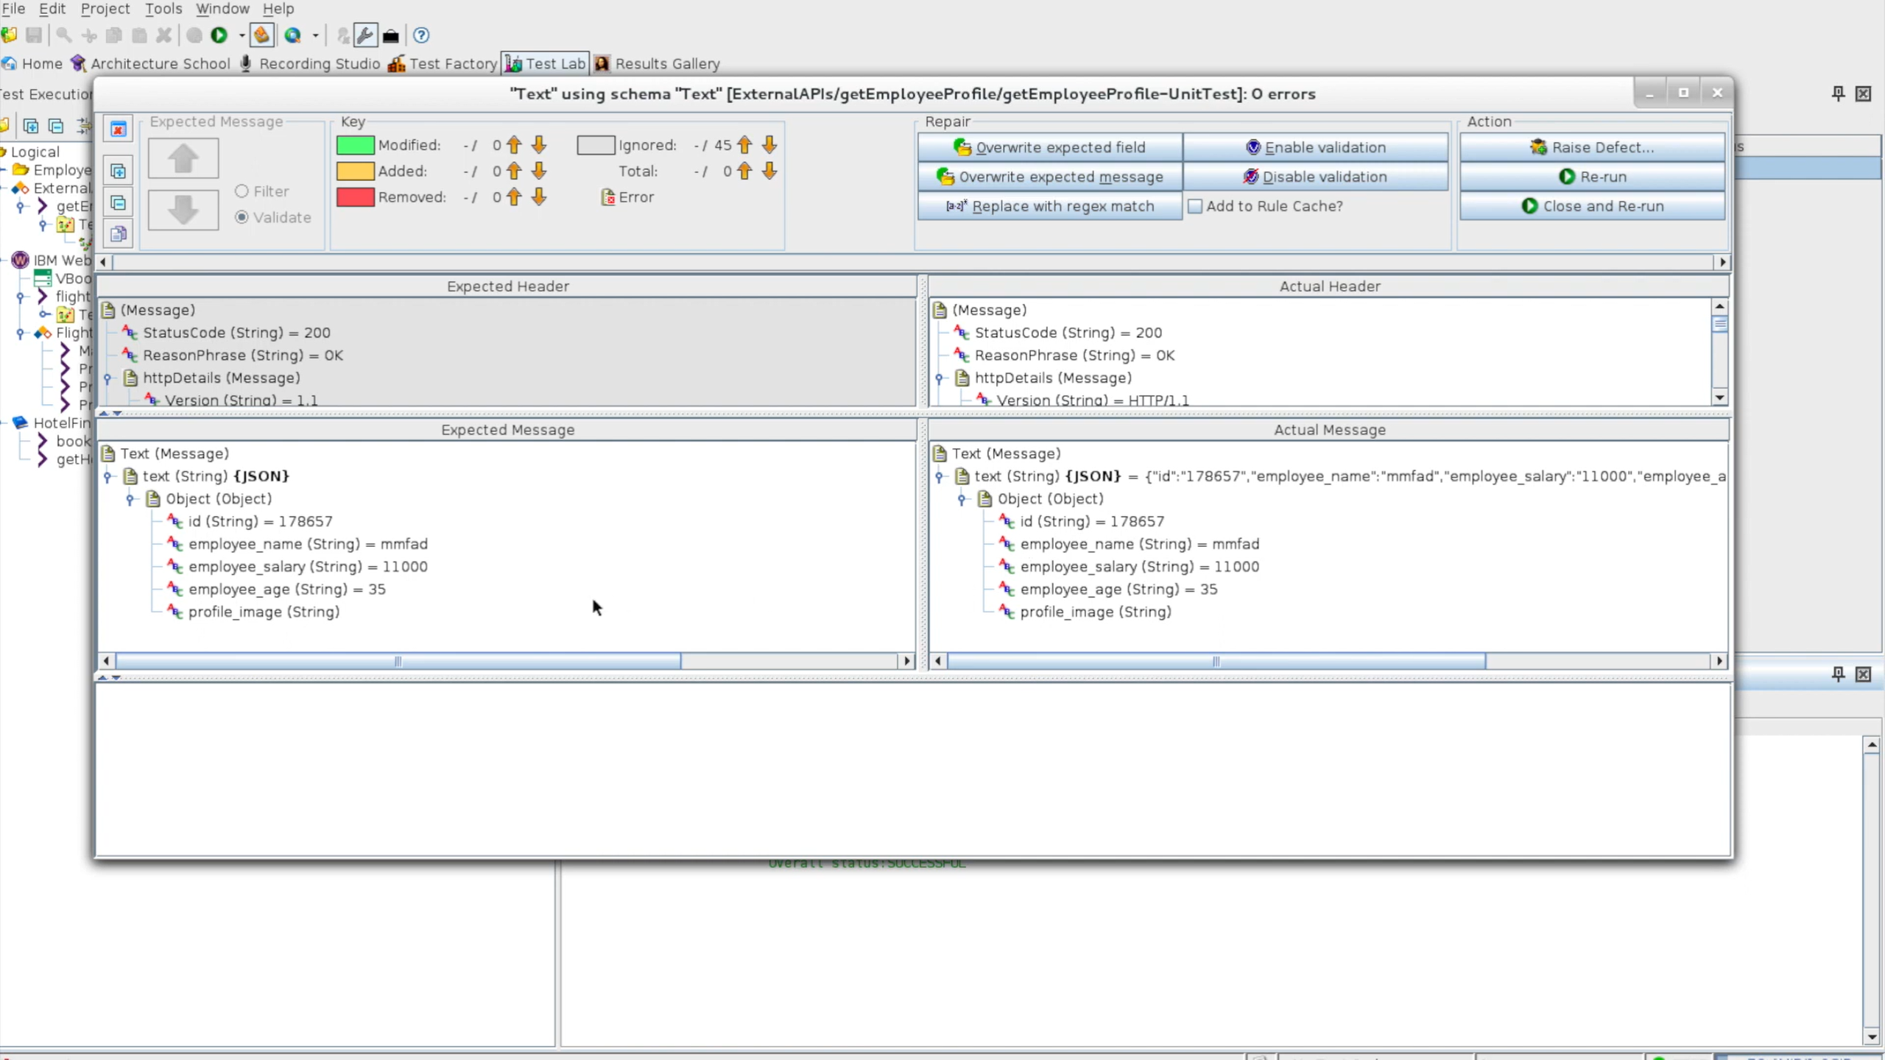

Slide 41
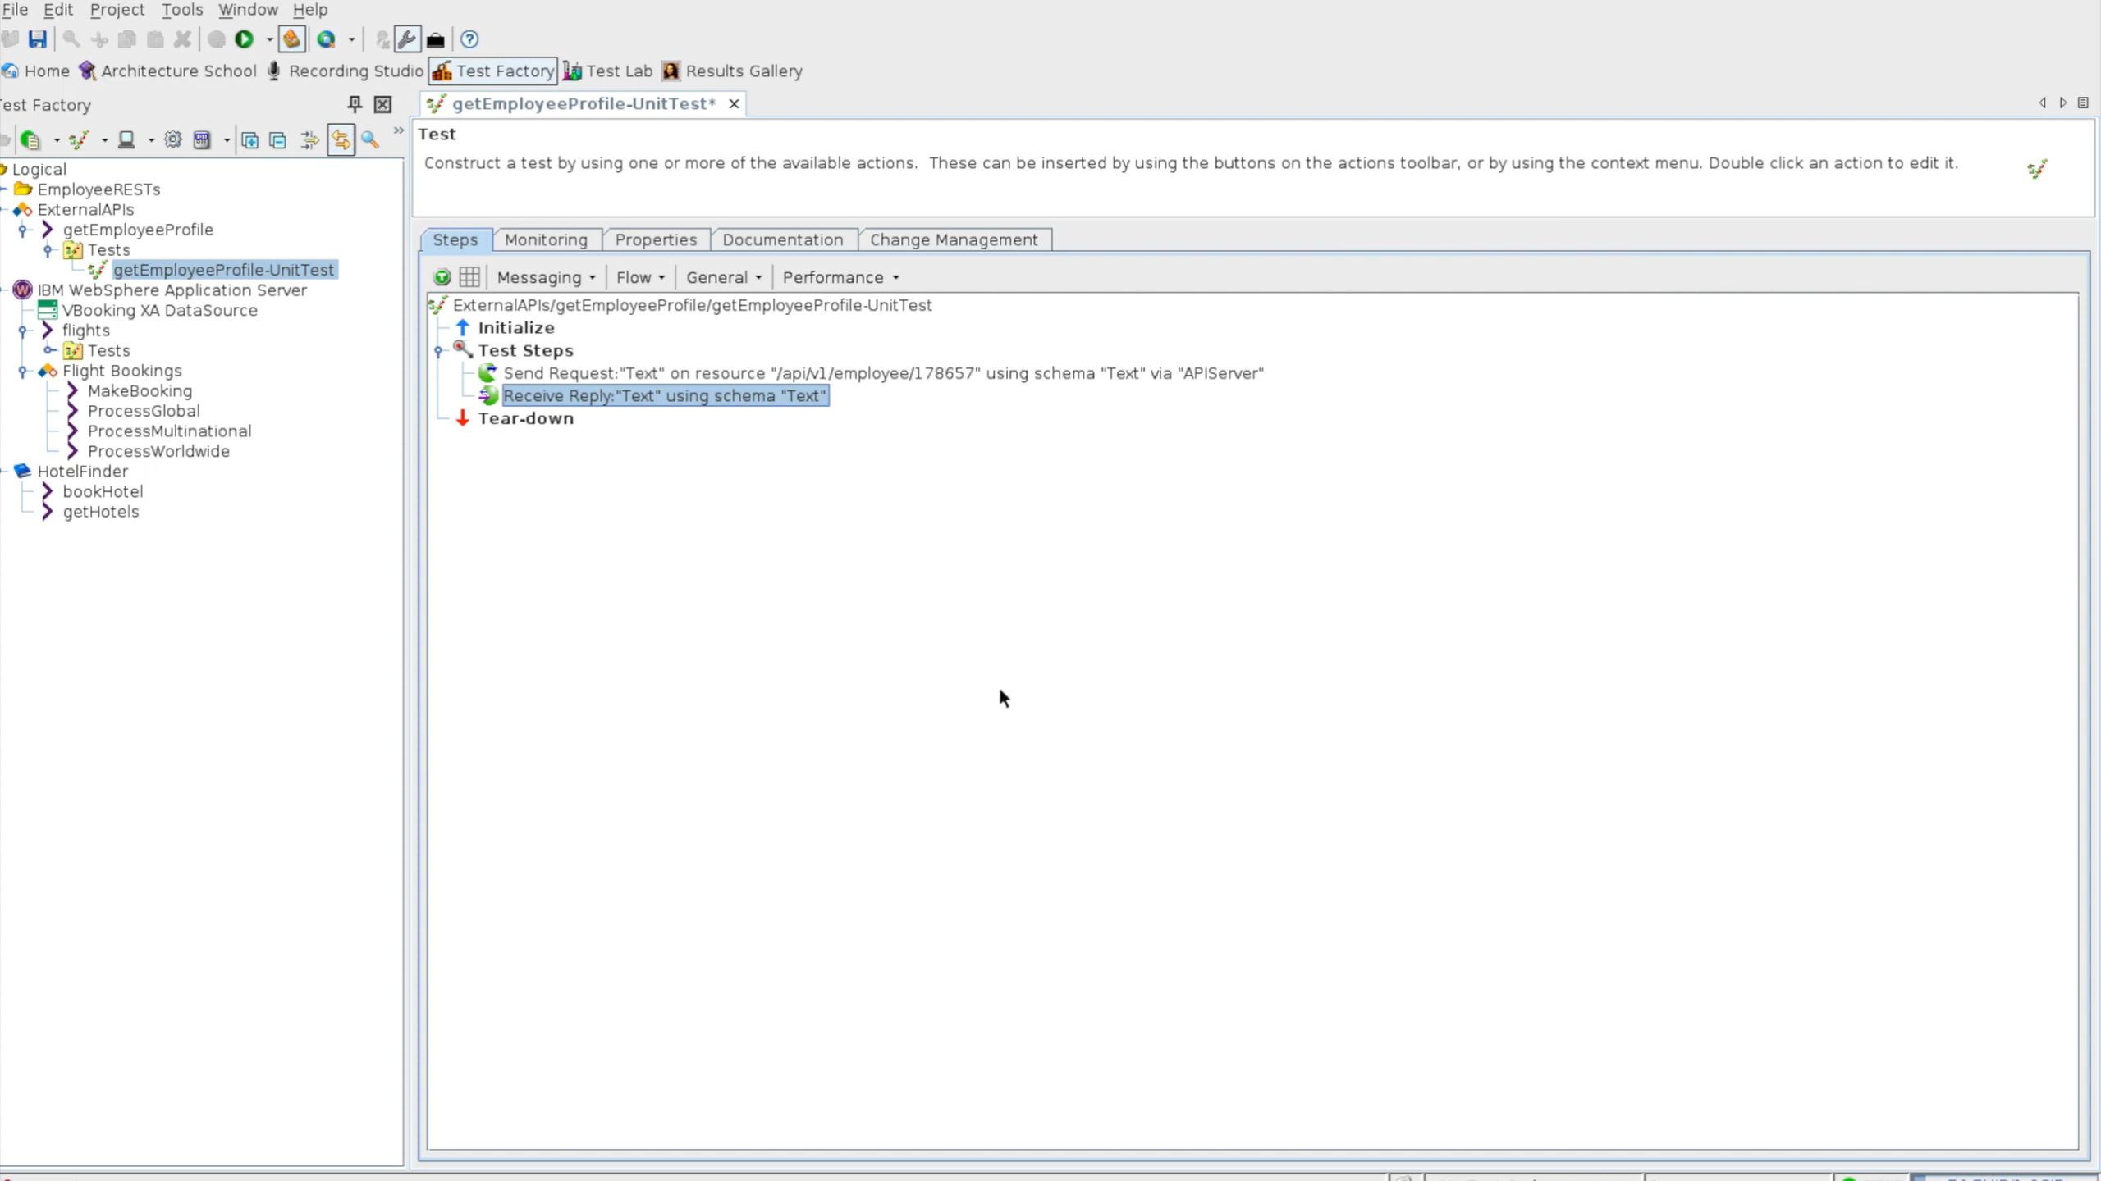
Edit and modify message

Slide 42
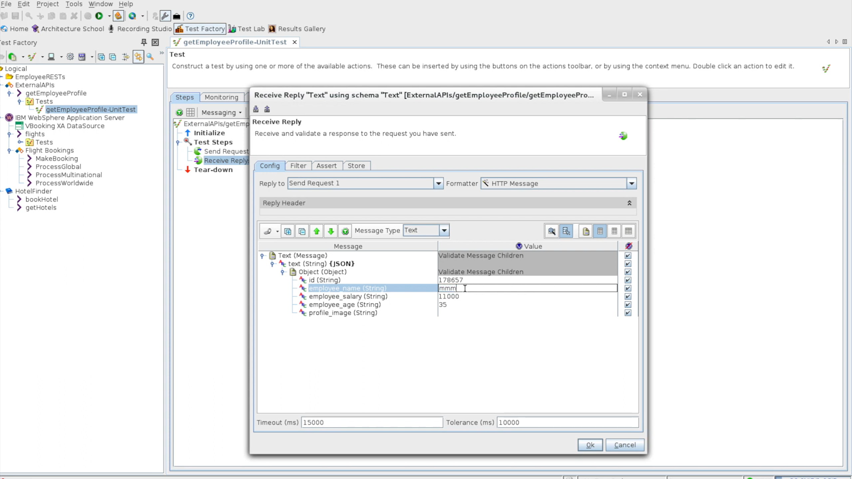

Slide 43
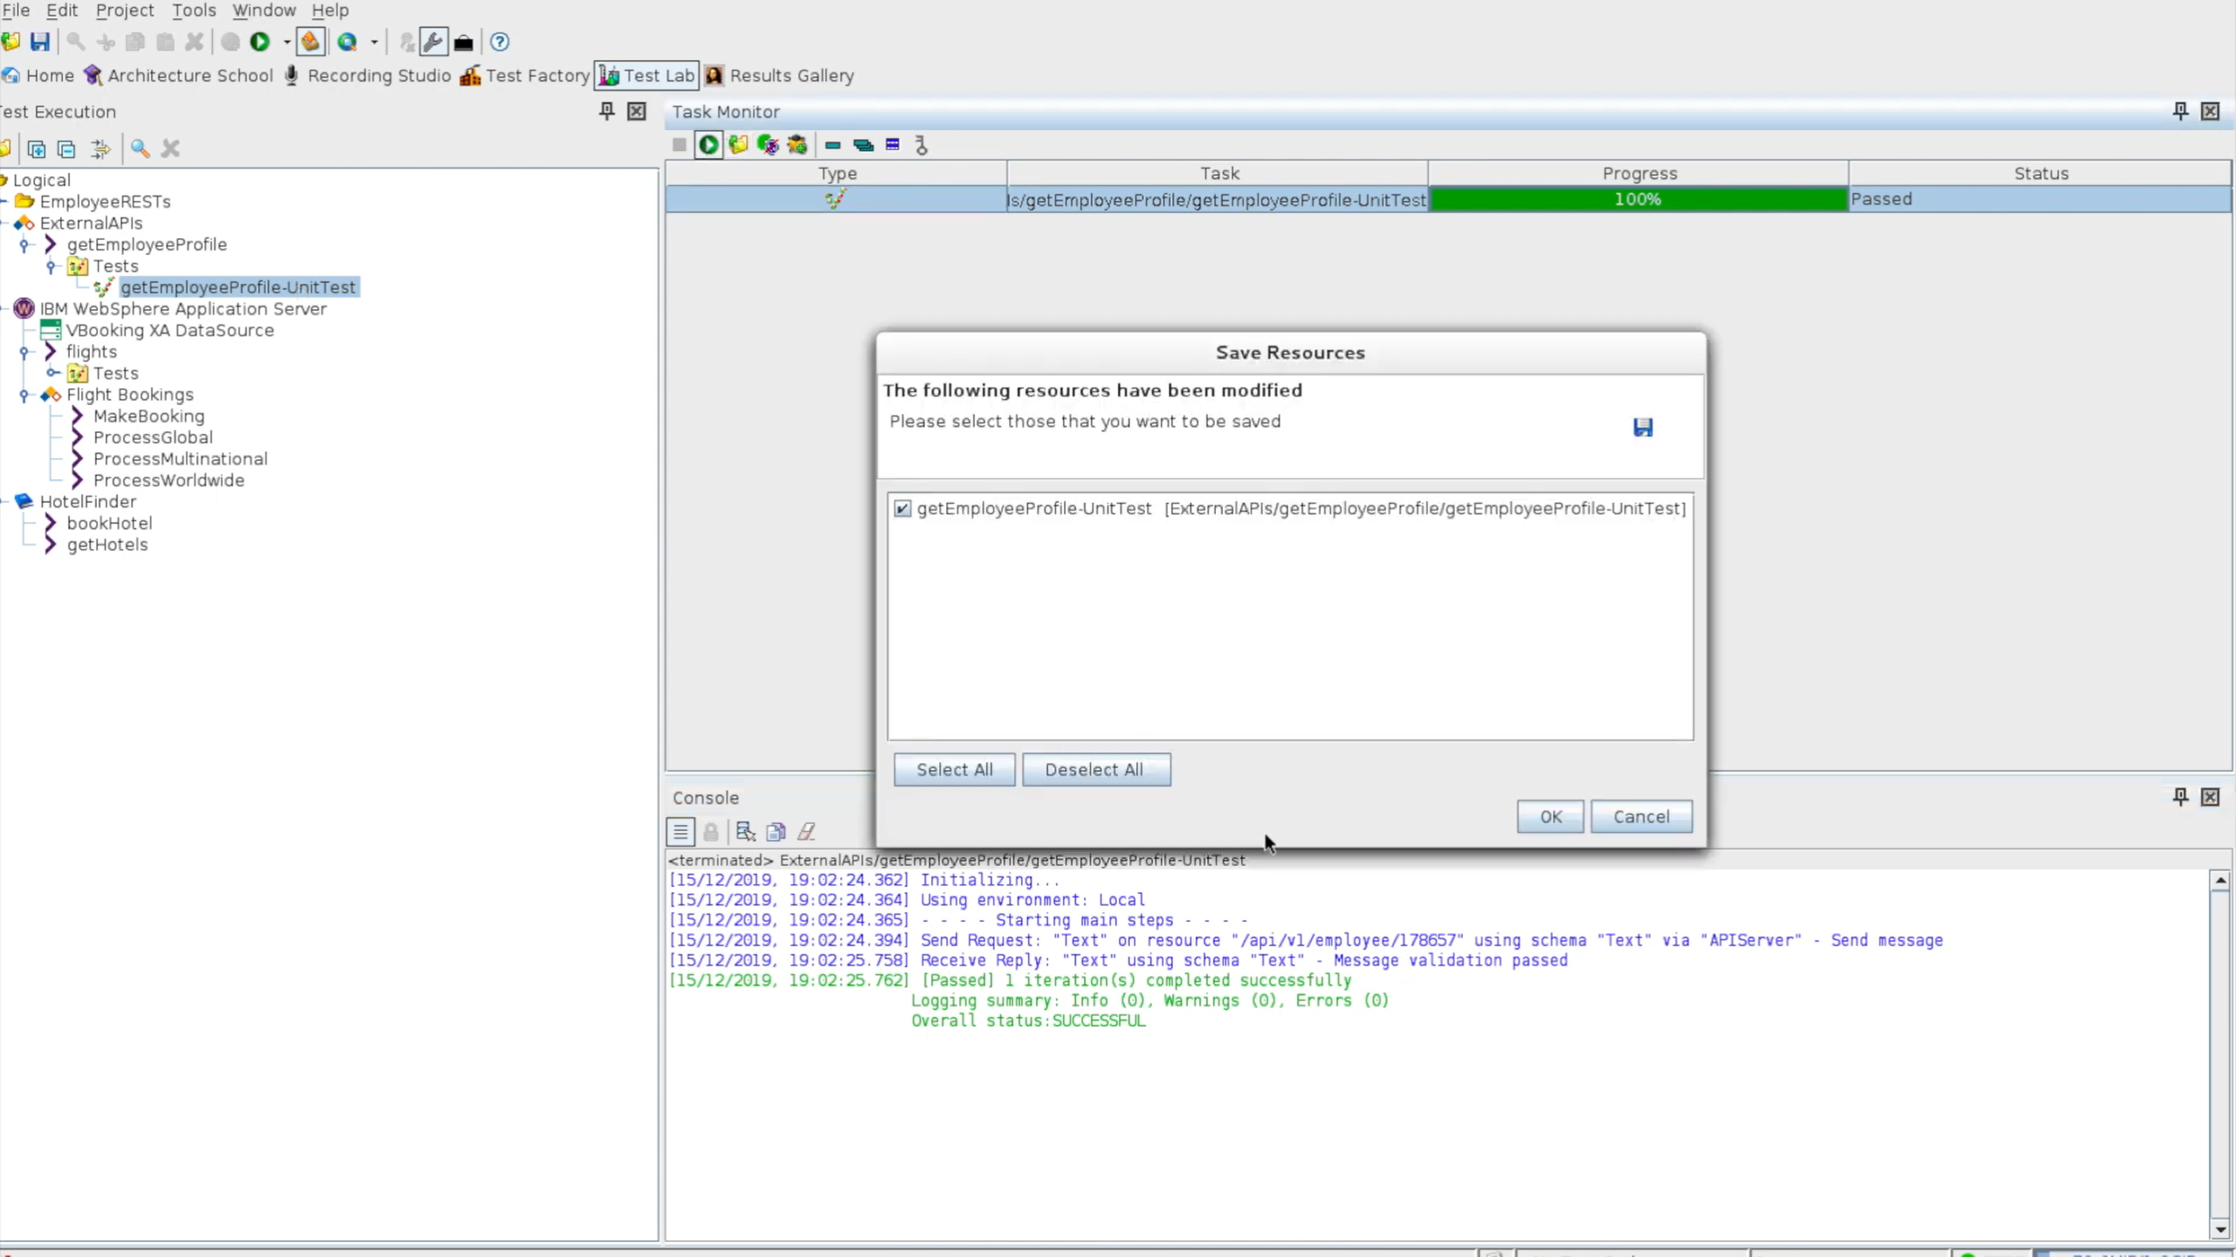
Rerun

Slide 44
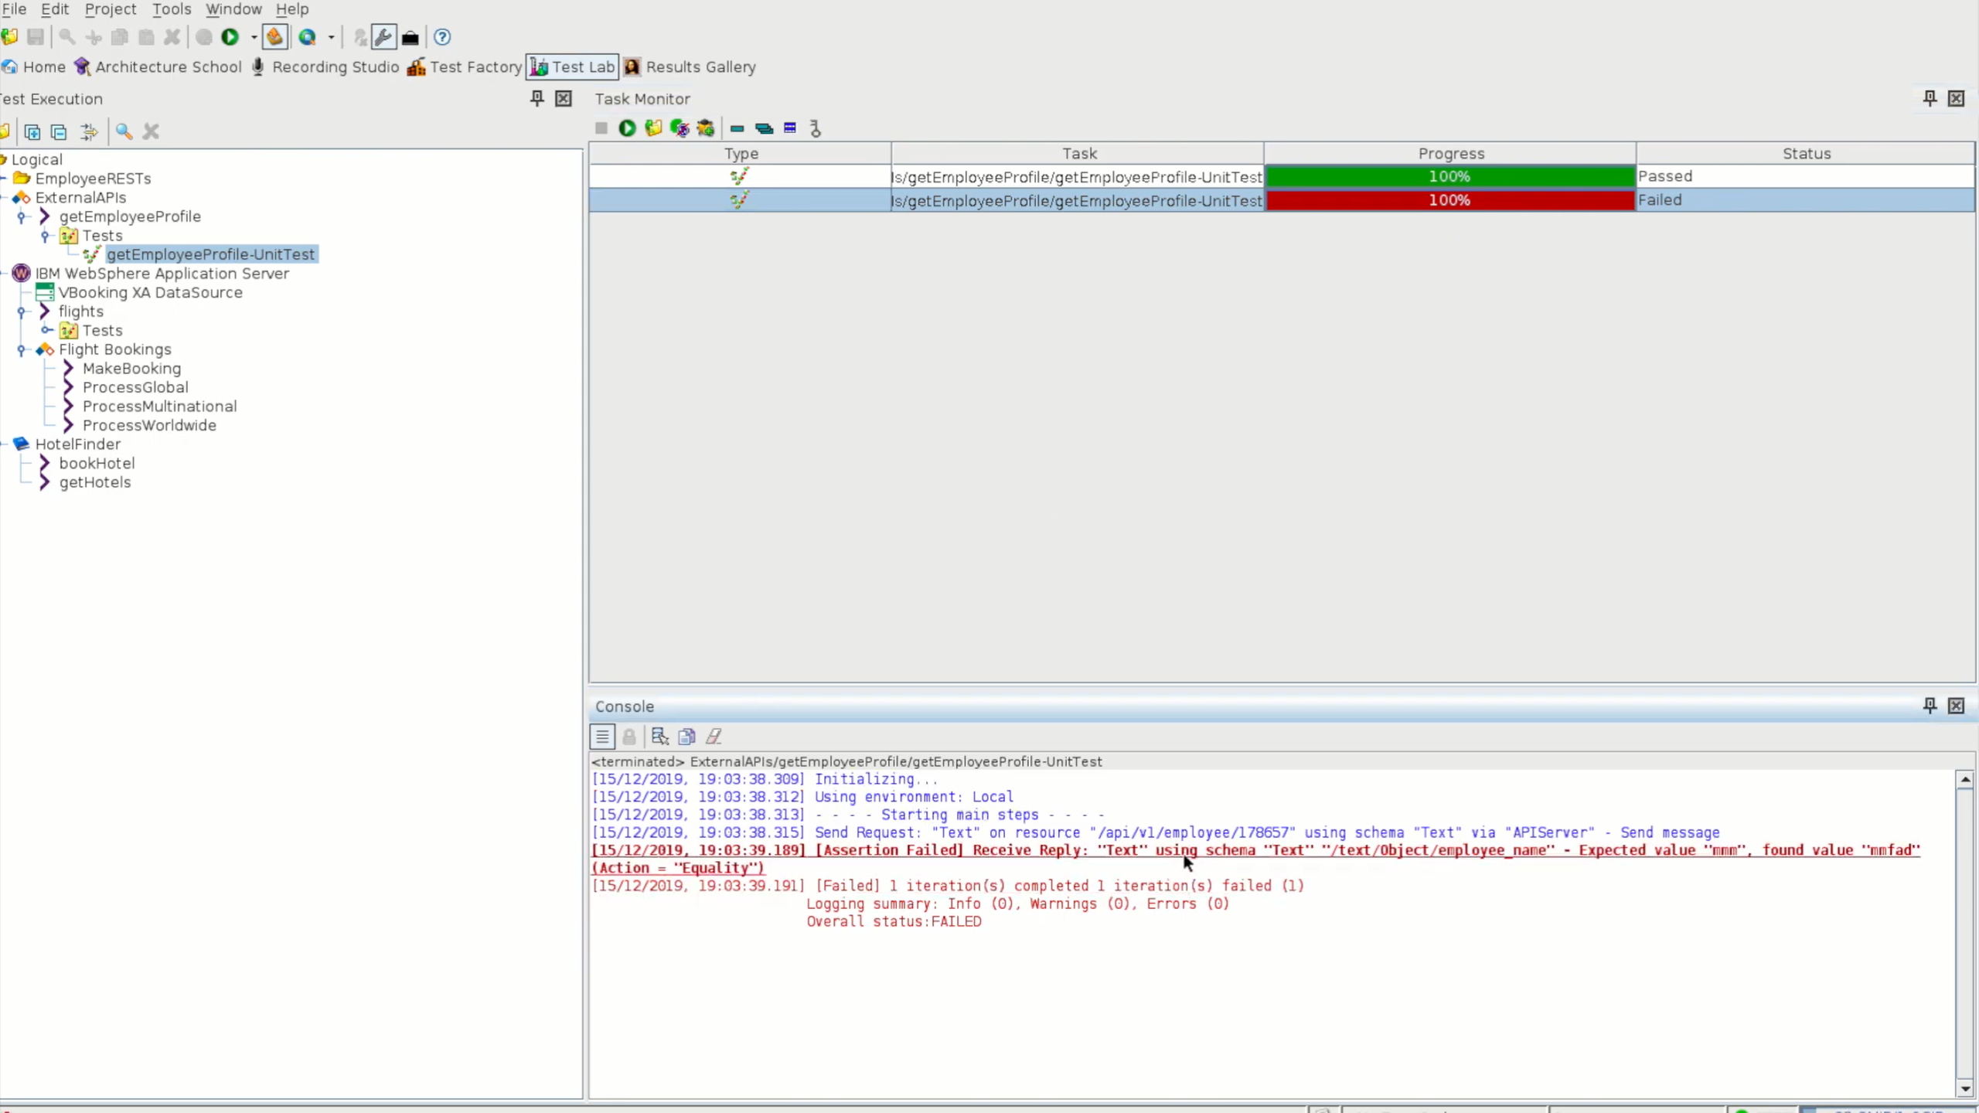

Slide 45
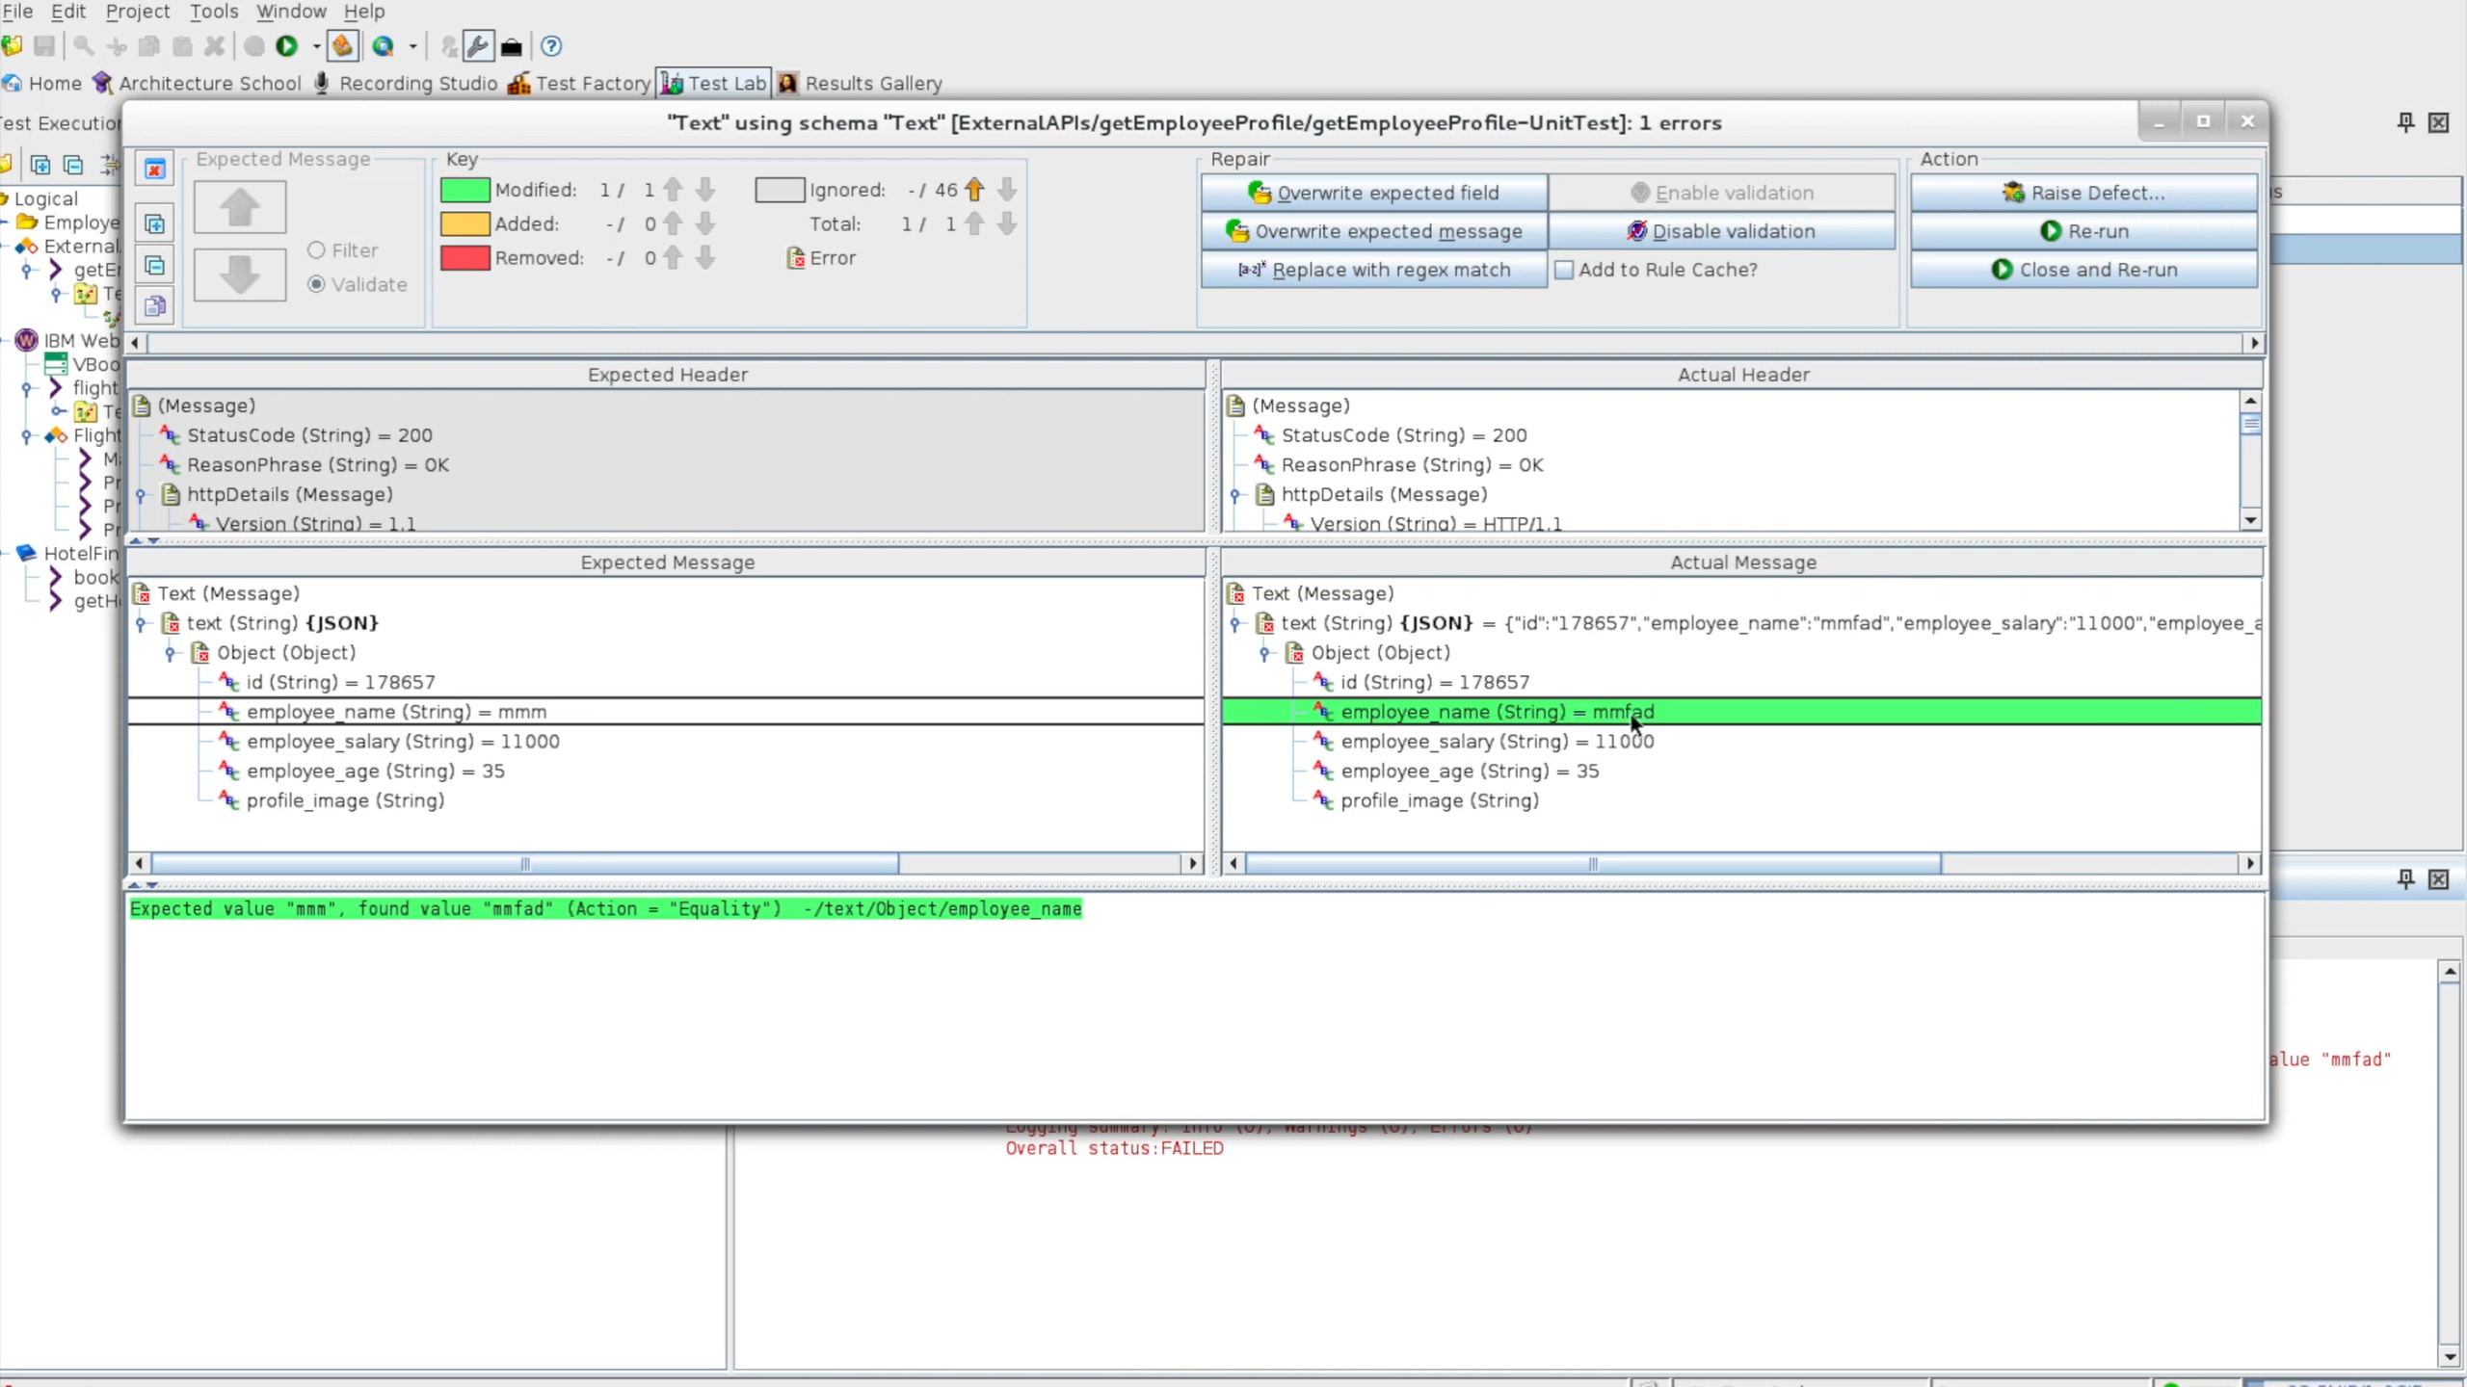

Slide 74
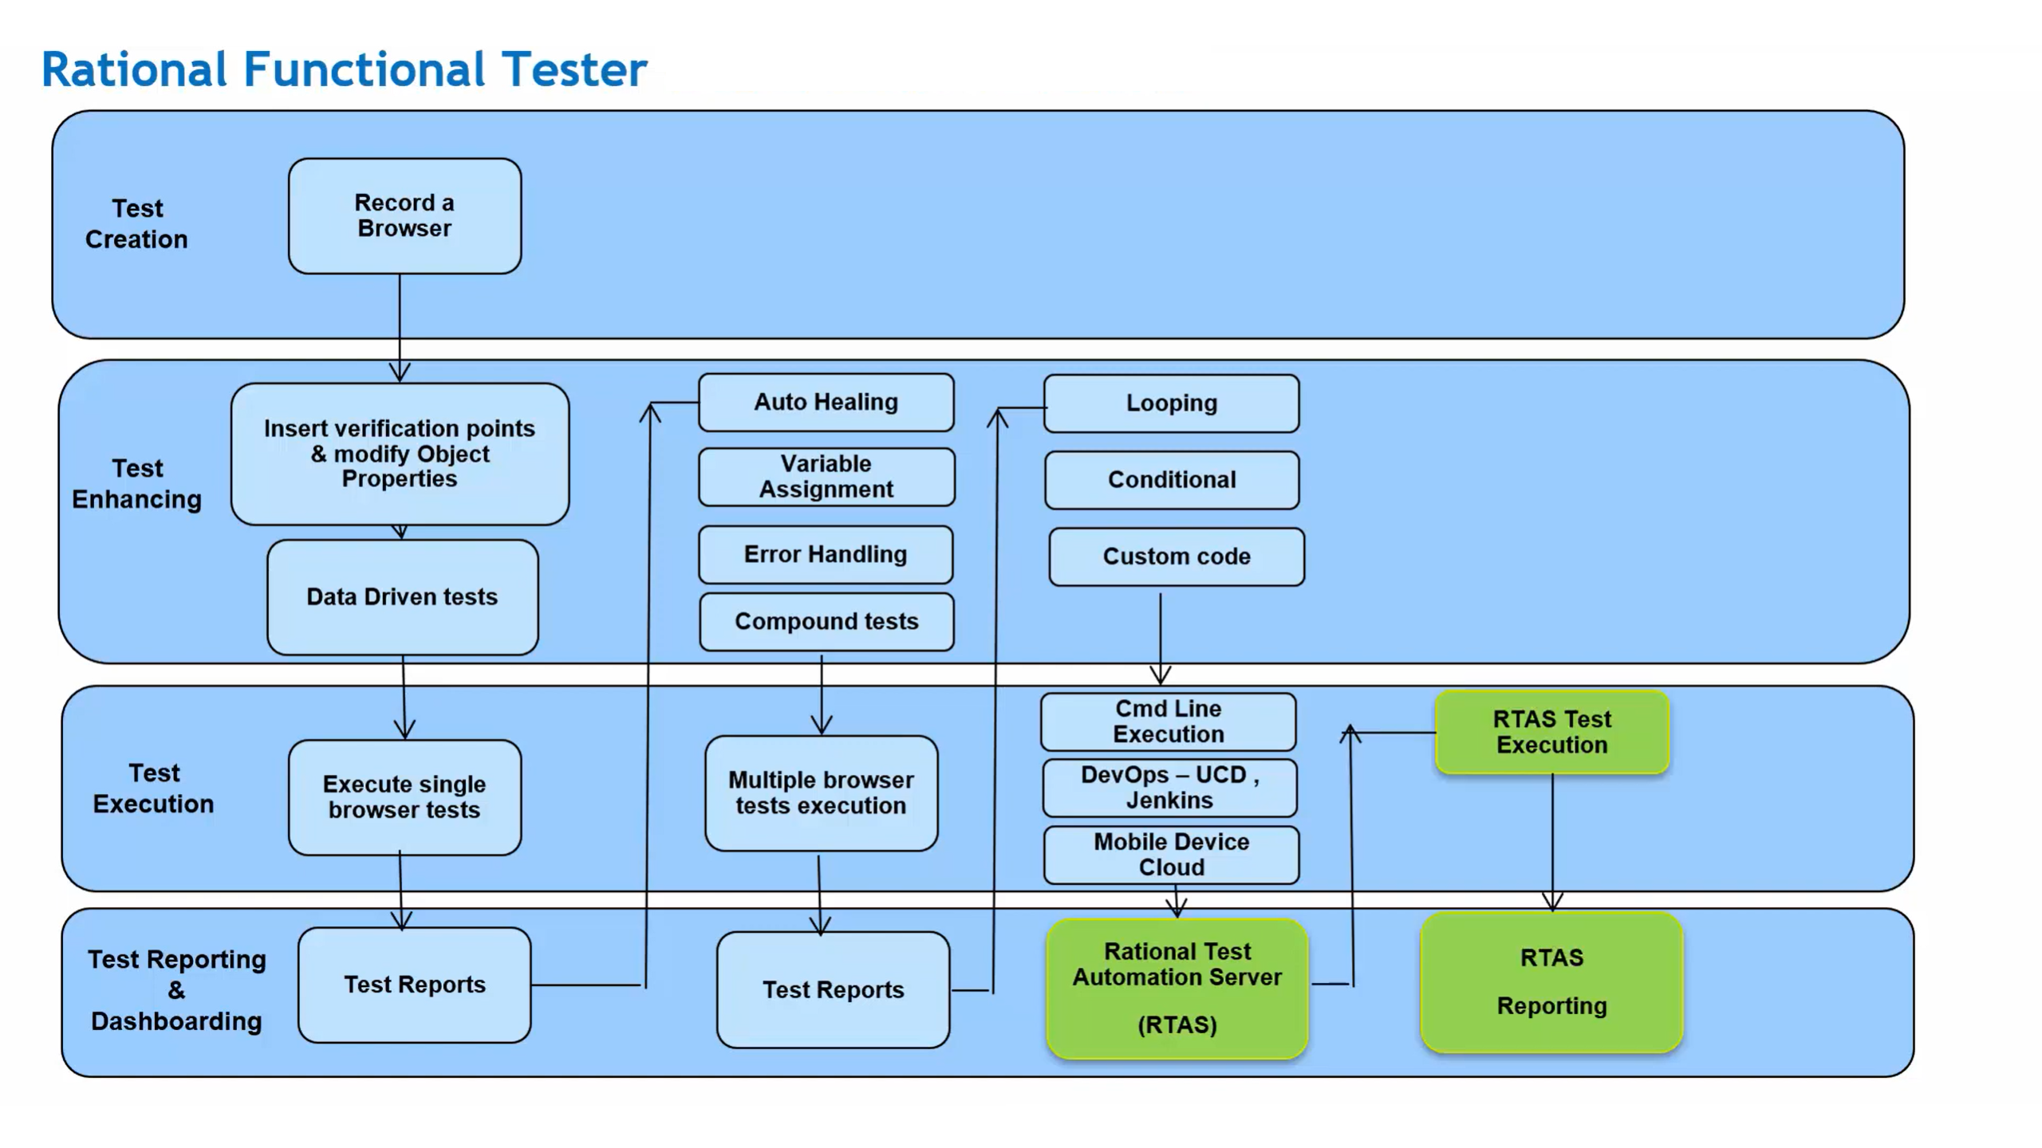

Slide 75
Questions ???

